Slide 1
Leankit versus
Jordan Nguyen;
Receiving Inspection Technologist

Slide 2
Edwards LifeScience

Slide 4
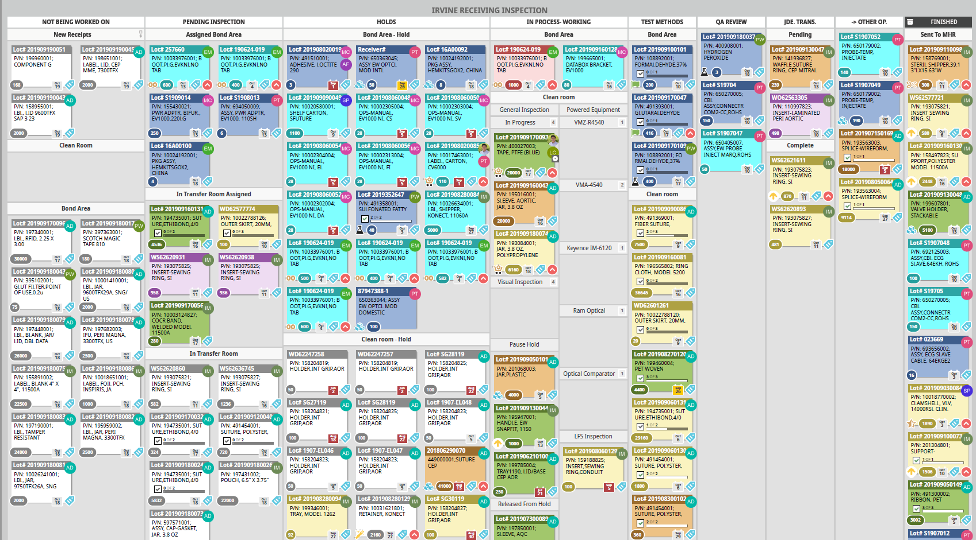
Grassroot Beginnings
No visibility
- Lack of visibility between teams, departments and sites
No accountability
- Who is doing what and when
No centralized system
No communication
Notes:
Leankit was introduced to the team in May of 2018 where we were trying to solve an issue with visibility with outside costumers (Planners/Buyers)
We just signed up for a trial and tried to make it work and see if it could help us in our area
Our major issues was that our inspectors were spending just as much time emailing and calling out to people as they were inspecting.
Led to longer inspection cycle times
Too many lots going on hold
More issues because inspectors were trying to solve their own issues
Showed that we had a bigger issue than just visibility.

Slide 5
Leankit Timeline
May 2018 Leankit Introduction in IIM Receiving Inspection
Jan. 2020 Consolidation of Leankit accounts throughout Edwards with new function
Dec. 2019 Developed account merge function in collaboration with Leankit.
Sept. 2018 First ever JDE to leankit integration GO LIVE
Jan. 2019 Introduction of Zapier application to expand Leankit Usage for communication
Sept. 2020 ELA signed with Planview
Nov. 2019 Build ELA Proposal with Leankit for Unlimited user license agreement to reduce cost of licenses by almost 9%
Dec. 2018 First year ended with 77 Licenses
Dec. 2019 End with 227 Licenses
Feb. 2021 Current with 617 licenses
Notes:
24% cost savings by signing ELA

Slide 6
Standardization
Notes:
Deploy a standard for board layouts and usage of cards
Allowed for rapid deployment and growth as well as ease of training
Allows users to quickly understand information from board to board

Slide 7
Example Of Use Cases
Below are just a few examples of how Leankit is being used across Edwards globally and between so many cross functional teams/functions. There are many more boards that support other functions across the company.
IIM Receiving Inspection- Uses to visualize quantity of lots pending inspection to be released for production.
IIM Microbiology Labs- All labs supporting the Irvine plant have begun to use leankit to track and communicate progress of test samples should it be if samples have been received, test, put on hold, failed, and completed.
Daimler Warehouse MHR to STK- Test environment in development to visualize material after it is finished being inspected by receiving inspection teams and before it is actually available to be sent to the production floor.
CR Wet Plant Tier 3 Accountability Board- Uses Leankit to track action items for the upcoming and current week with assigned cards to show action item owners.
Japan PMDA Audit board- Tracker for audit requests. Easy visual to see who is preparing what material and when material is ready for auditor.
Draper Chemistry Laboratory- Board to show what samples have been submitted and documented for testing. Also shows current status of test results and provides histrocial data.

Slide 8
Where we are now
617 active users
- Ended 2018 with 77 users
- 57% increase in users since Jan. 2020
170 active boards
Cross functional boards
R&D, Audits, Labs, Projects, manufacturing, HR
Active at all main sites
- All manufacturing sites
- Satellite Offices
Notes:
Averaging 25 net users monthly
Not advertising but word of mouth
We estimate a user count of active users to hit 1300 by June 2021 or 9% of the company
Based on projects we have outlined to added bulk users and monthly adds.
Queue of users pending invites

