Slide 1
Rewiring Strategy to Delivery
2021 Industry Update: Agile Transformation and Platform Implications

Slide 2
The Strategy to Delivery Rewire
Changing World
Of Work
Realizing
Agile-at-Scale
STRATEGY
Making The
Product Shift
DELIVERY
Accelerating
Innovation
Disruptive
Markets
#WFH
COVID

Slide 3
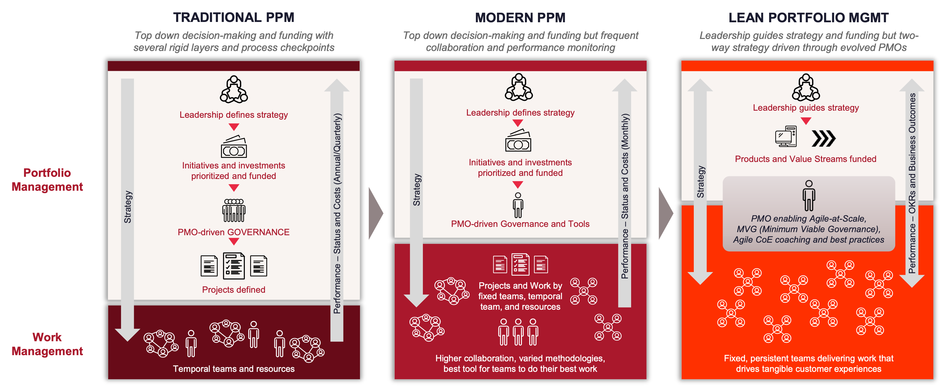
Strategy to Delivery for Every Enterprise

Slide 4
Planview Platform 2021
Innovation Management
Strategic Portfolio Management
Enterprise portfolio management
Lean portfolio management
Financial planning/funding/forecasting
Portfolio visibility
Enterprise Architecture
Objective and Key Results (OKR)
Leadership Teams (BU/IT)
EPMOs
Finance
Enterprise Architects
PORTFOLIO MANAGEMENT
Visual Portfolio Planning
PMOs – Agile and Traditional
Agile CoEs and RTEs
Product leadership
Line-of-Business leadership
Portfolio Kanban
Agile Program Management
Portfolio Prioritization
Capacity Planning
Roadmapping
Project Teams
Kanban Teams
Scrum for Software Development Teams
Agile
Business Teams
Continuous
Delivery Teams
WORK MANAGEMENT
Business Operations
Marketing/Content
Sales
HR
DevOps
IT Operations
Software Development

Slide 5
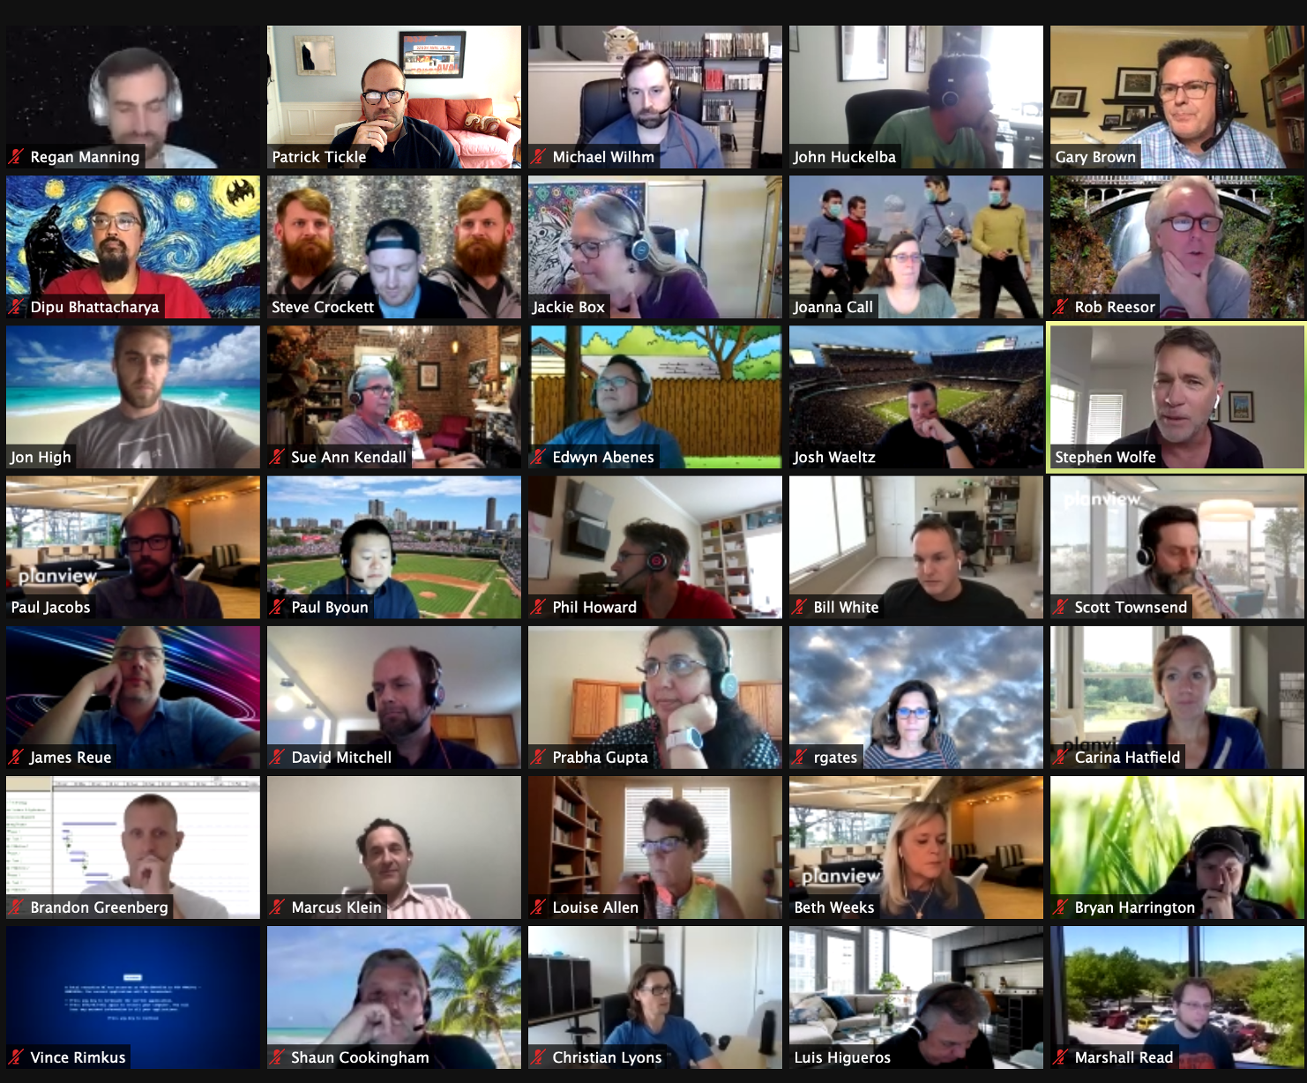
#WFH
VIDEO
MESSAGING

Slide 6
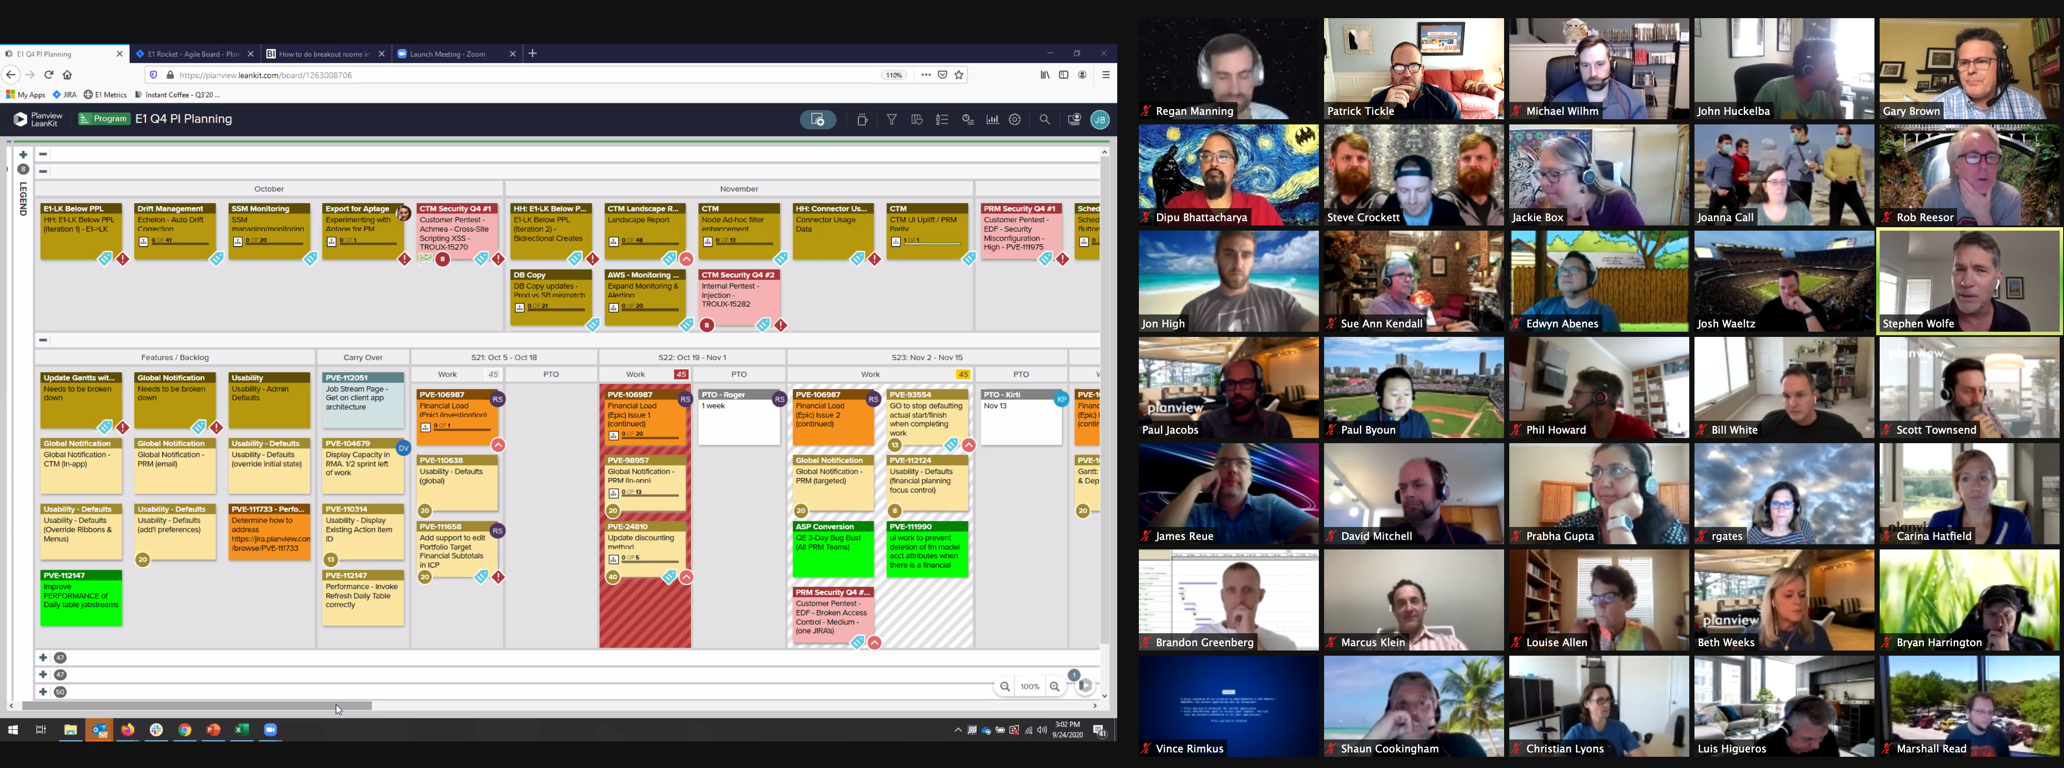
Planning and Delivery at Planview #PDFH
PLANNING
VIDEO
MESSAGING

Slide 7
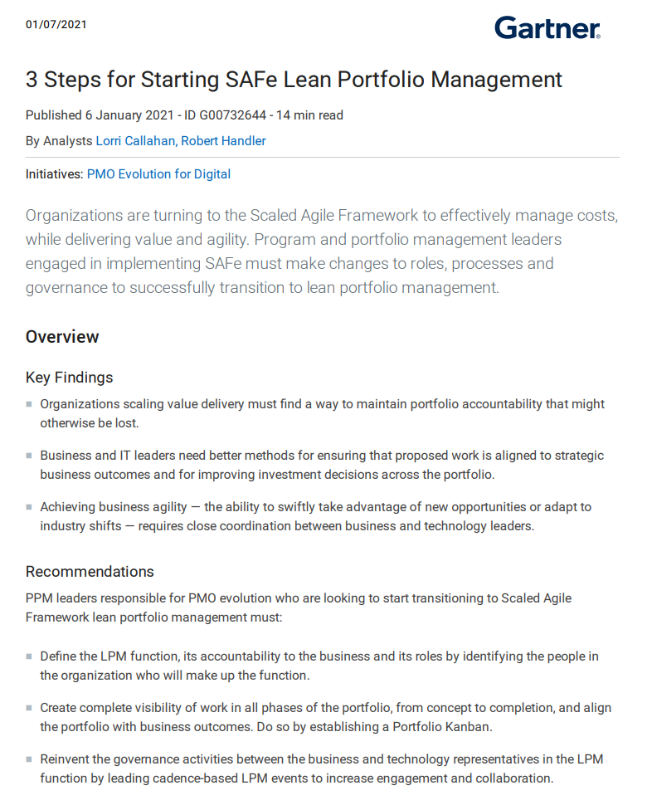
Starting Lean Portfolio Management
“PPM leaders responsible for PMO evolution must: Create complete visibility of work in all phases of the portfolio, from concept to completion, and align the portfolio with business outcomes.
Do so by establishing a Portfolio Kanban.” 1/06/2021
Notes:
3 Steps for Starting SAFe Lean Portfolio Management
Published 6 January 2021 - ID G00732644 - 14 min read
By Analysts Lorri Callahan, Robert Handler

Slide 8
Rewiring Strategy to Delivery for Today’s World
How it has traditionally worked
High
ANNUAL PLAN
NEXT ANNUAL PLAN
Q1
Q1
Q2
Q2
RESET
Q3
Q3
ON-STRATEGY FACTOR
Q4
Q4
Low

Slide 9
Rewiring Strategy to Delivery for Today’s World
The risk in many organizations as we speak
High
We have lost our traditional planning mechanisms
High touch, intensive ceremonies (offsites, summits, etc.) that supported longer horizons
At a time of massive market disruptions
ANNUAL PLAN
Q1
Q2
STRATEGY ATROPHY
Q3
ON-STRATEGY FACTOR
Q4
Q2
Q1
Q3
Q4
Low

Slide 10
Rewiring Strategy to Delivery for Today’s World
Business Agility at Scale that is a must have for today
BUSINESS AGILITY
Continuous on-strategy calibration
Program Increment (PI)-driven with in-flight visibility
Incremental planning fits for today's WFH and disruptive markets

Slide 11
Accelerating On-Strategy Delivery The opportunity in coming together with Clarizen and Changepoint
>4500
Customers
Worldwide
Creating an unmatched community of PMOs, PPM & PSA practitioners, and enterprise-class solutions
Accelerate PSA leadership and innovation
Bring Enterprise Agile Planning and Kanban leadership to every customer
Being and ideal partner with business leaders and teams on their Portfolio, Work and Agile transformation journey
>1.5M
End Users
>1000
Employees
Worldwide
Notes:
Breadth/depth in concise faction
Full spectrum
Unmatched depth and breadth
INTERNAL AND EXTERNAL VERSION – GLOBAL FOOTPRINT
Accelerating strategy to delivery has never been more critical to organizations. Disruptive market conditions are driving the transformation of how leaders and teams build plans and get work done. In this environment, enterprises are looking for partners with the vision, expertise, and scale to rewire how they operate. Planview, Clarizen, and Changepoint are all leaders in connecting strategy to delivery and we are coming together in a bold move to create an unmatched community of PPM and PSA practitioners and enterprise-class solutions. In combination with Planview’s market leadership in Lean and Agile, there is no platform provider better positioned drive innovation and partner with customers in accelerating their Portfolio, Work, and Agile transformation journey.

Slide 12
Thank You

