Slide 1
Spigit Office Hours
Challenge Expert Review
Notes:
Good morning, afternoon, and evening. Welcome to Spigit Office Hours, my name is ___________ , the ____________ for Spigit. Today, I’m joined by _____________, responsible for ________________ at Spigit. First off, thanks for taking some some to join us today, to learn about Challenge Experts and the Review process. Before we get started, a few housekeeping items:
First, you may ask questions using the chat or Q&A feature in the Zoom panel. Additionally, since this is a small group, I’ve opened up participant audio, so you may join the discussion directly if preferred. You should be able to mute and unmute your personal lines at will - we just ask that you stay muted when not talking - to avoid background noise.

Slide 2
AGENDA:
Challenge Overview
Challenge Expert Practice
Demonstration
Q&A
Notes:
The general flow of this session will be as follows: I’ll review a typical challenge process and point out where the expert review process typically takes place. Next, we’ll dive into the details of the practice and tools needed to perform Expert Reviews. Lastly I’ll pull up a real challenge and demonstrate some of our learnings.
This should take about 20 minutes or so and afterward, I’ll stick around for the remainder of the hour just in case you have any other questions pertaining to the expert review process or any other topics of interest.

Slide 3
Available Resources
Spigit Learning Center
Spigit Help Center & Support
Spigit Professional Services
24/7 Access to online tutorials
Tutorials, Chat, and Break/fix
We’ll do it for you
Notes:
Last thing before we get started. Depending on your appetite for learning, there are additional resources available such as our Learning Center - where you have 24 by 7 access to program and technical related lessons, our Help and Support center, where you can view articles, chat with our support team, and create tickets if needed, and finally our professional services team where you can simply pay us to do the work for you.
OK, let’s start with an example challenge process to help set the stage.

Slide 4
Typical Challenge Flow
Soft Launch
Ideation & Collaboration
Ideation Closed
Expert Review
Pairwise
Selection
1/1 to 1/5
1/5 to 1/15
1/16 to 1/19
1/20 to 1/26
1/27 to 2/2
1/27 to 2/2
Selected individuals seed ideas and test site.
Participants can submit ideas, comments, and vote on other’s ideas.
Active Moderation starts
Ideas meeting graduation criteria advance
Participants can continue to comment and vote. Idea posting is disabled.
Active Moderation continues
Ideas meeting graduation criteria advance
Voting and Commenting is disabled.
Expert panel performs detailed review of ideas
Ideas meeting graduation criteria advance
Participants prioritize ideas using pairwise.
Winners and/or top ideas announced and awards distributed.
Prioritized ideas presented to sponsor/s.
Sponsor assigns next steps for incubation or implementation.
Notes:
This is a typical challenge flow. However it’s important to note that this process can vary depending on the use case, so be sure to connect with your Challenge Team to understand the exact timing and activities pertaining to your event. In this example, each column depicts a Phase, where various activities take place and facilitate ideation through to selection. <describe the phase where moderation starts and stops and how in some cases they may be asked to help moderate but to not evaluate ideas when in moderation mode.>

Slide 5
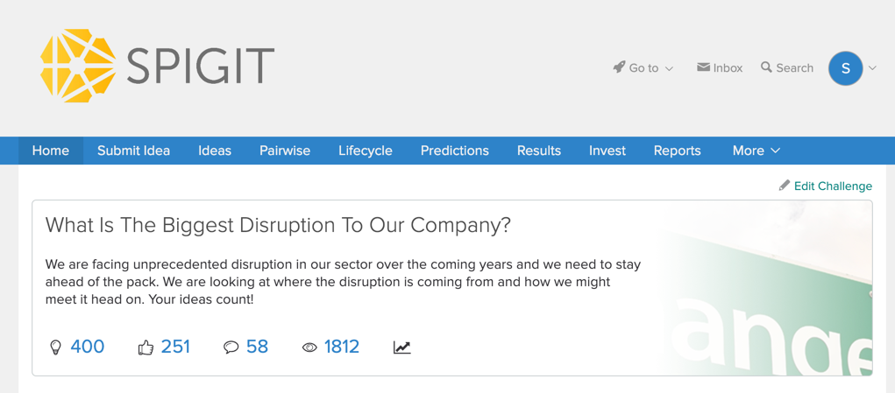
Challenge Question
Notes:
In addition to the challenge activities and timing, it’s also import to become familiar with the challenge question. The challenge question is the opportunity we’re attempting to solve and will help frame the expert review process. When evaluating ideas, it’s important to reference the challenge question and overall sponsor goals for the challenge.

Slide 6
Challenge Expert Practices
Notes:
Now that we understand the objective of the challenge and when we need to be involved, let’s move on to the practice of expert reviews.

Slide 7
Principles of Challenge Expert Reviews
Assess Value
Narrow
Selections
Understand the Concept
Leverage Knowledge
Be transparent
Understand the Concept
Read the entire Idea before evaluating.
Reach out to the idea owner if needed.
Leverage Knowledge
Help the sponsor, owner, and audience understand how valuable this idea might be to the organization.
Be transparent
Stay emotionally neutral when assessing.
Be honest, but professional.
Notes:
As a subject matter expert, it’s likely that you’ve been chosen by a challenge sponsor to help determine the potential impact and value of an idea. Besides providing this pertinent information, your evaluations help narrow down the best ideas to the select few that merit a closer look, perhaps that’s a business case, a prototype, or potentially something that’s ready to implement. First, you’ll want to review the idea that’s been assigned to you in detail, including any comments and attachments. Next, leveraging your own expertise and knowledge, help the sponsor and audience understand the impact of the idea by completing the review form. Lastly, ensure you stay professional but honest, staying emotionally neutral and including any useful comments if necessary. Your reviews and comments will be visible to the audience by default.

Slide 8
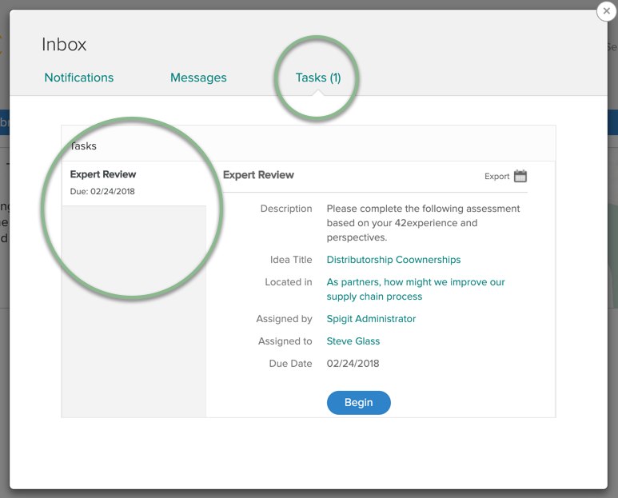
Expert Practices
The primary tools needed for Reviewing Ideas
List and begin outstanding reviews directly from the Tasks page in your Inbox.
By default, an email will also be sent when a task is assigned.
Notes:
Once the system assigns you a review, a task will be assigned and available in your Inbox. By default, an email will also be sent. Be sure to align with your Challenge lead to determine when you are expected to perform the reviews.

Slide 9
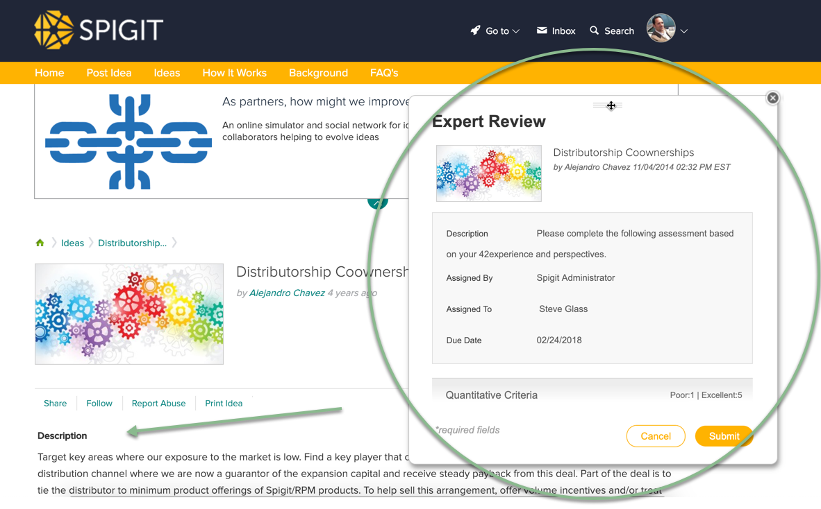
Expert Practices
The primary tools needed for Reviewing Ideas
Review the idea, comments, and attachments.
Begin the Expert Review in the popup.
To ask clarifying questions of the idea owner, use the share option, @ mention to notify someone in the comment thread or use the private message feature if discretion is needed.
Notes:
Once you begin a review, a lightbox is presented and can be moved around on the page. This will allow you to review the idea and comments before starting the review. If needed, ask any questions using the share option, @ mention to notify someone in the comment thread or use the private message feature if discretion is needed.

Slide 10
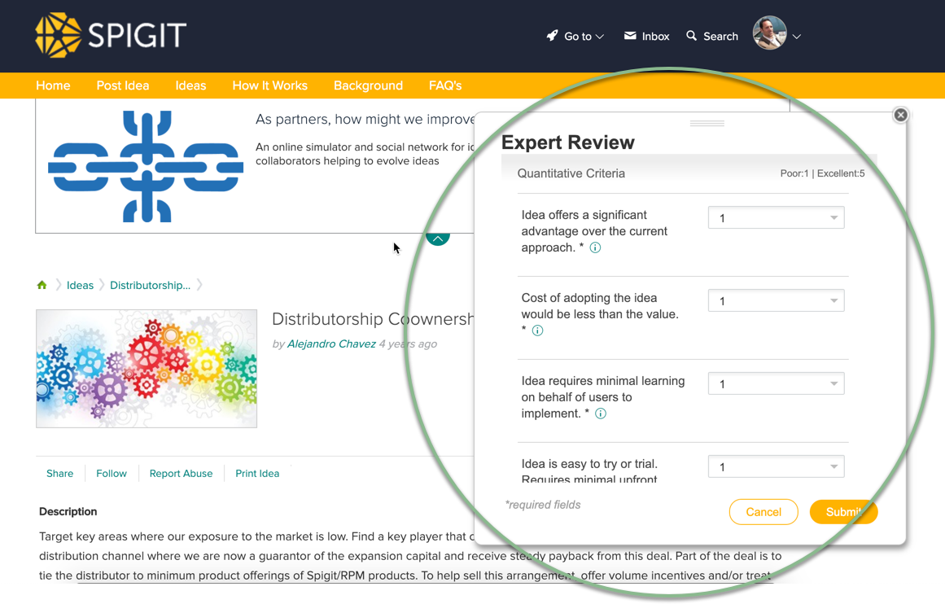
Expert Practices
The primary tools needed for Reviewing Ideas
Complete the qualitative and quantitative criteria in the popup review box and hit ”Submit” when complete.
Align with your Challenge Lead to understand the criteria that you will use to evaluate ideas in your challenge.
Notes:
Complete the review form and hit submit when complete. The task will be available for everyone to see once you publish it. Be sure to align with your challenge lead on the exact criteria, scale, and number of reviews to be performed. In most cases, multiple reviews are completed for each idea, scores averaged, and then analyzed to determine if the idea will move forward or not.

Slide 11
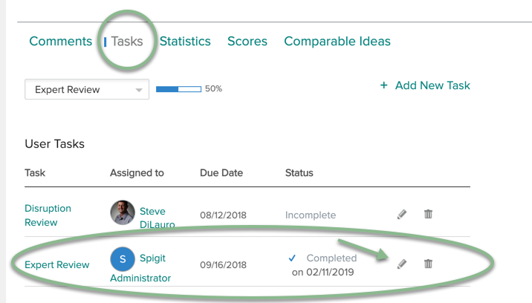
Expert Practices
If needed, your review can be changed before the idea graduates, by navigating to the idea page, selecting ”Tasks” and clicking the pencil next to your review.

Slide 12
Demonstration

Slide 13
Open Question and Answer Period
Use the ‘Raise Hand’ or ‘Q&A’ feature to ask a question.

