Slide 1
Spigit Office Hours
Challenge Moderation
Notes:
Good morning, afternoon, and evening. Welcome to Spigit Office Hours, my name is ___________ , the ____________ for Spigit. Today, I’m joined by _____________, responsible for ________________ at Spigit. First off, thanks for taking some some to join us today, to learn about Challenge Moderation. Before we get started, a few housekeeping items:
First, you may ask questions using the chat or Q&A feature in the Zoom panel. Additionally, since this is a small group, I’ve opened up participant audio, so you may join the discussion directly if preferred. You should be able to mute and unmute your personal lines at will - we just ask that you stay muted when not talking - to avoid background noise.

Slide 2
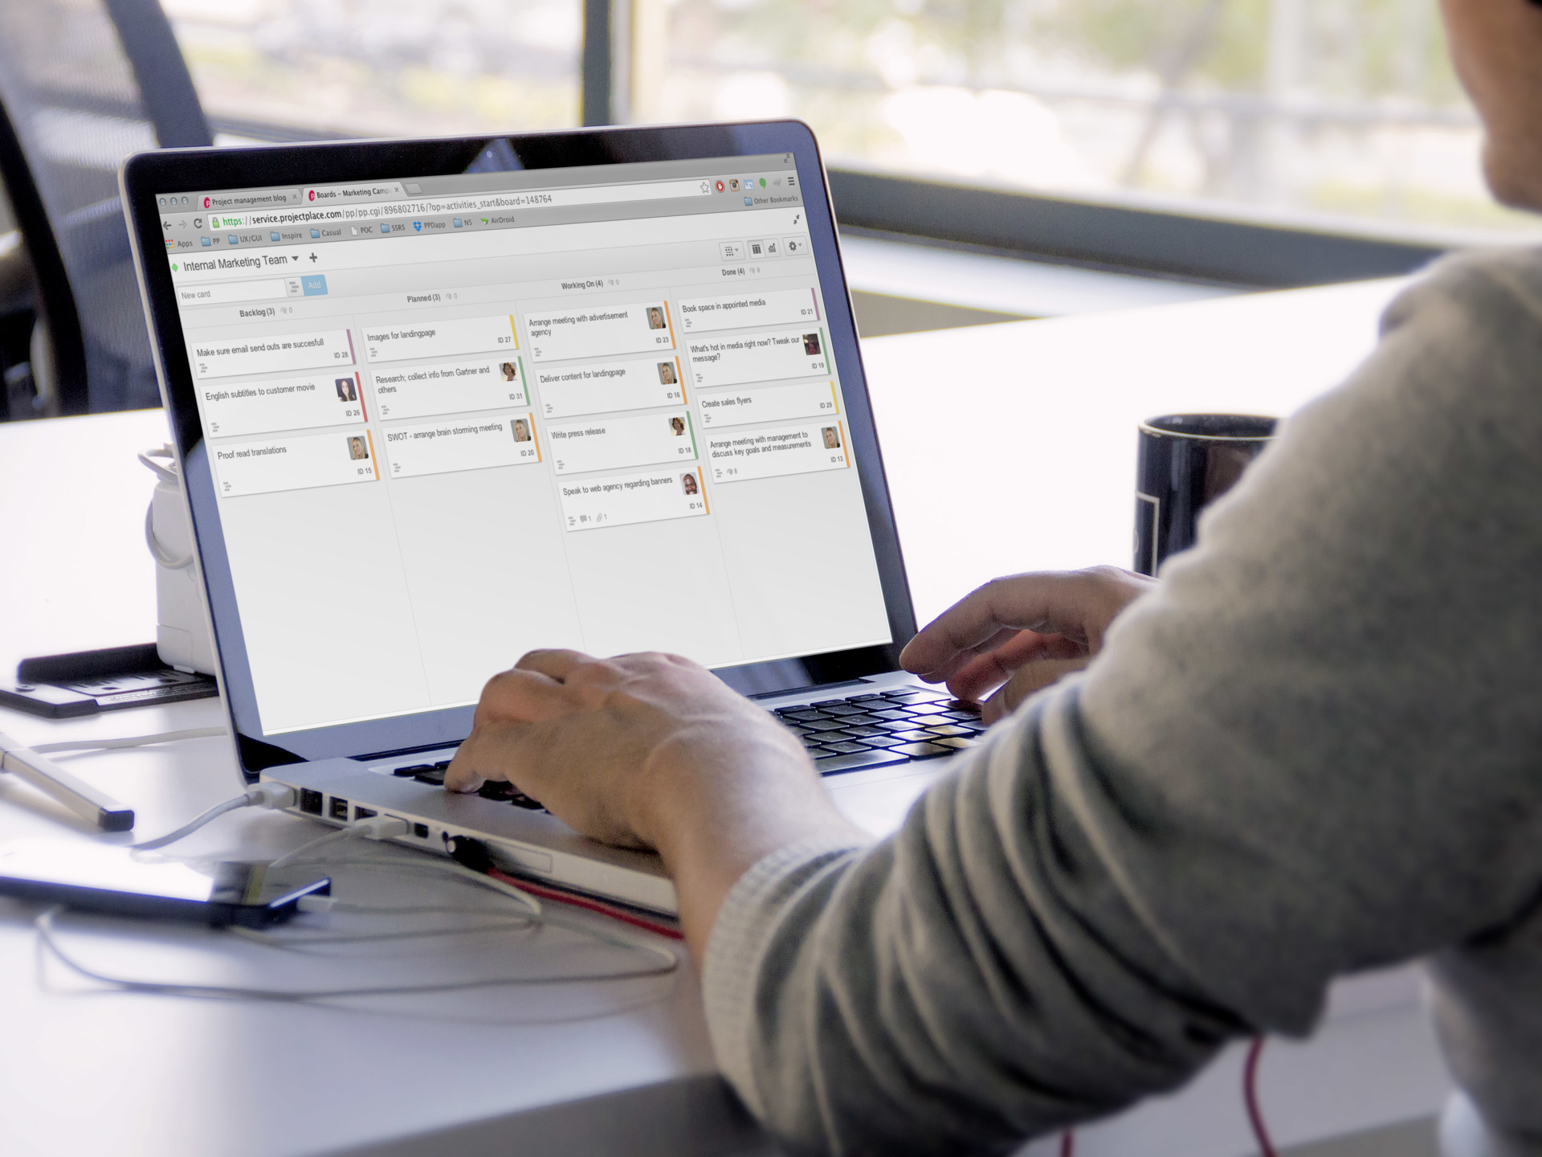
AGENDA:
Challenge Overview
Challenge Moderation Practice
Example Scenarios
Demonstration
Q&A
Notes:
The general flow of this session will be as follows: I’ll review a typical challenge process and point out where moderation typically takes place. Next, we’ll dive into the details of the moderation practice and tools and best practice to consider when moderating a challenge. I then have a few example scenarios to help put everything into context, and lastly I’ll pull up a real challenge and demonstrate some of our learnings.
This should take about 20 minutes or so and afterward, I’ll stick around for the remainder of the hour just in case you have any other questions pertaining to moderation or any other topics of interest.

Slide 3
Available Resources
Spigit Learning Center
Spigit Help Center & Support
Spigit Professional Services
24/7 Access to online tutorials
Tutorials, Chat, and Break/fix
We’ll do it for you
Notes:
Last thing before we get started. Depending on your appetite for learning, there are additional resources available such as our Learning Center - where you have 24 by 7 access to program and technical related lessons, our Help and Support center, where you can view articles, chat with our support team, and create tickets if needed, and finally our professional services team where you can simply pay us to do the work for you.
OK, let’s start with an example challenge process to help set the stage.

Slide 4
Typical Challenge Flow
Soft Launch
Ideation & Collaboration
Ideation Closed
Expert Review
Pairwise
Selection
1/1 to 1/5
1/5 to 1/15
1/16 to 1/19
1/20 to 1/26
1/27 to 2/2
1/27 to 2/2
Selected individuals seed ideas and test site.
Participants can submit ideas, comments, and vote on other’s ideas.
Active Moderation starts
Ideas meeting graduation criteria advance
Participants can continue to comment and vote. Idea posting is disabled.
Active Moderation continues
Ideas meeting graduation criteria advance
Voting and Commenting is disabled.
Expert panel performs detailed review of ideas
Ideas meeting graduation criteria advance
Participants prioritize ideas using pairwise.
Winners and/or top ideas announced and awards distributed.
Prioritized ideas presented to sponsor/s.
Sponsor assigns next steps for incubation or implementation.
Notes:
This is a typical challenge flow. However it’s important to note that this process can vary depending on the use case, so be sure to connect with your Challenge Team to understand the exact timing and activities pertaining to your event. In this example, each column depicts a Phase, where various activities take place and facilitate ideation through to selection. <describe the phases and where moderation starts and stops>

Slide 5
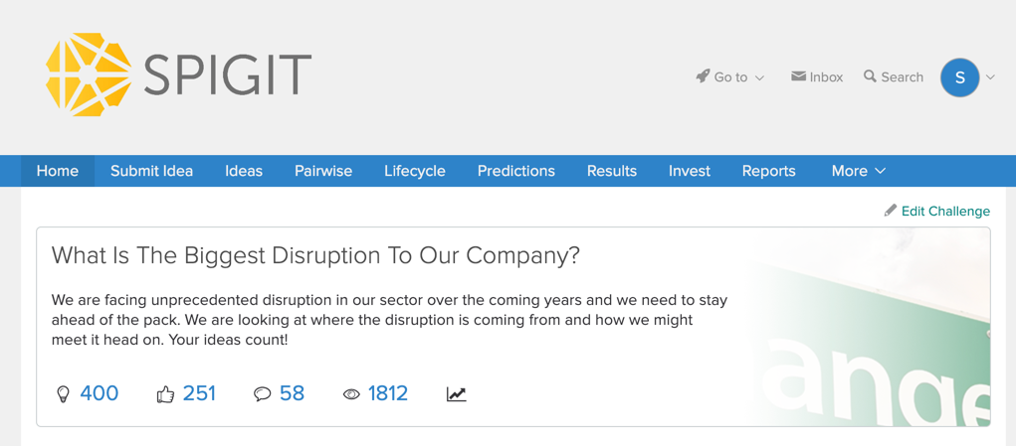
Challenge Question
Notes:
In addition to the challenge activities and timing, it’s also import to become familiar with the challenge question. The challenge question is the opportunity we’re attempting to solve and will be the guiding light for much of the moderation practice. In this example challenge question, we’re asking the audience to identify potential disrupting factors in the industry and how we might address them.
Good moderators do not necessarily need to be experts on the topic, but rather have an understanding of the overall challenge goal and objective and be strong and empathetic communicators.

Slide 6
Challenge Moderation Practices
Notes:
Now that we understand the objective of the challenge and when we need to be involved, let’s move on to the practice of moderation in the context of our challenge.

Slide 7
Principles of Challenge Moderation
Increase
Understanding
Increase
Perspectives
Focus – Focus the audience
Catalyst – Expand the thinking
Nexus – Expand the influence
FOCUS THE AUDIENCE
Identify and report out of scope ideas to the Challenge Lead.
Help participants understand comments are for building, voting is for showing support.
Help differentiate between similar ideas and/or report to admin for merging.
EXPAND THE CONCEPT
Help the innovator increase understanding among the audience.
Help uncover opportunities for expansion in different areas or the idea/business.
What is the primary advantage of this idea over the current state?
EXPAND THE INFLUENCE
To members with related interests.
To members with valuable perspectives.
Notes:
There are two primary goals of the moderator role: to increase the understanding of the idea and to increase the amount of perspectives applied to that idea. We achieve this through three actions:
First, helping the audience focus on challenge opportunity and the task at hand. Moderators should be watching for ideas that might be out of scope and discussing them with the challenge team to determine a response. Also, helping collaborators understand how to show support for ideas (by voting) vs. explaining why they support ideas. Additionally, moderators will help catch similar ideas and encourage the idea owners to differentiate them.
Next, moderators should be helping idea owners expand their idea. In some cases, idea owners simply wont know how to pitch or form their ideas fully. Moderators can help by asking key questions to help the owner improve their idea, increase the understanding of the concept, and articulate the value.
Lastly, Moderators can help connect people to ideas by bringing in people who many have important perspectives to add to the idea or individuals who may benefit from the potential solution.
Let’s look at the tools that enable these actions, and then review a few examples of these scenarios.

Slide 8
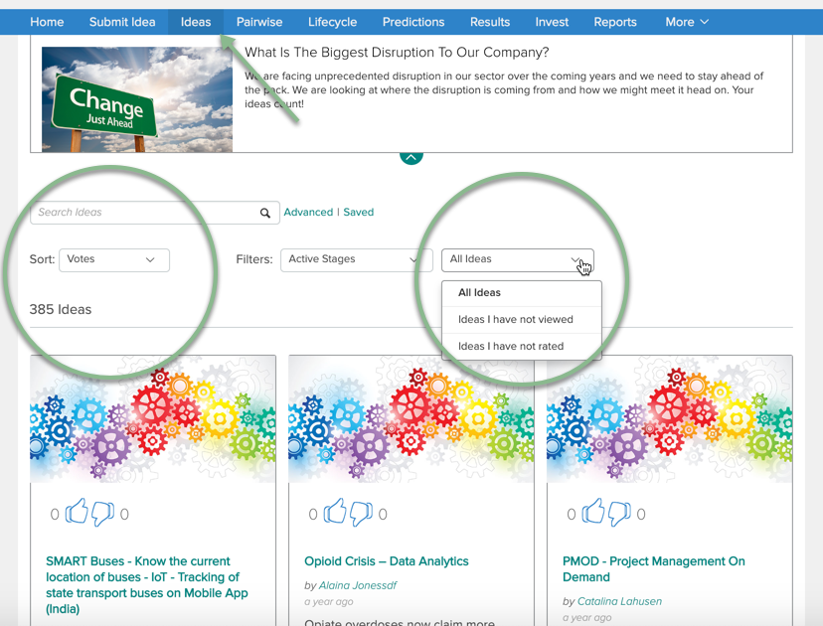
Moderation Practices
Set a goal for yourself to look at X number of ideas that have not received a lot of engagement to date (e.g., as a function of views, comments, and votes). Use the sorting and filtering features to assist.
Notes:
To help find the ideas that need the most help, set a goal to review X number of ideas per day and use the available sort and filter options on the ideas page to surface the ideas that have low views, comments, votes, or that you’ve not viewed before. Additionally, used the advanced search feature if you want to review ideas pertaining to a specific category or that contain specific values in the idea form. For example you may split the work with other moderators and only review those ideas that pertain to your business area, or your area of influence.

Slide 9
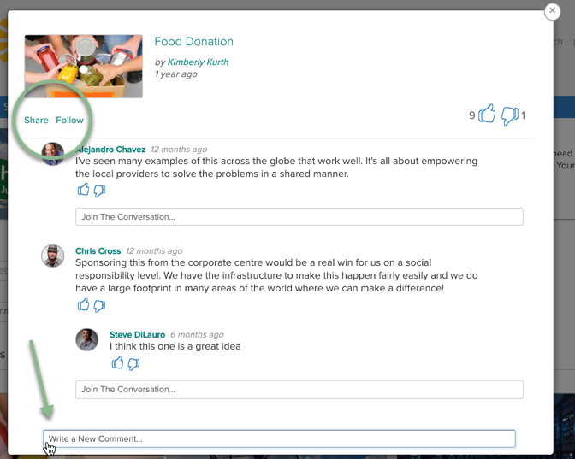
Moderation Practices
The primary tools needed for Moderation
Share
Comment
Follow
Use @ mentions to notify someone in the comment thread.
Notes:
Once you find an idea that needs your attention, there are a few tools to help you take action. The “share” option will allow you to send a message with a link to the idea to anyone with access to the challenge. You may also @mention someone in the comment and reply section. Both options will generate an email and an inbox message to the recipient unless disabled by the administrator. You also have the option of following the idea, which will provide you with notifications when something is updated.

Slide 10
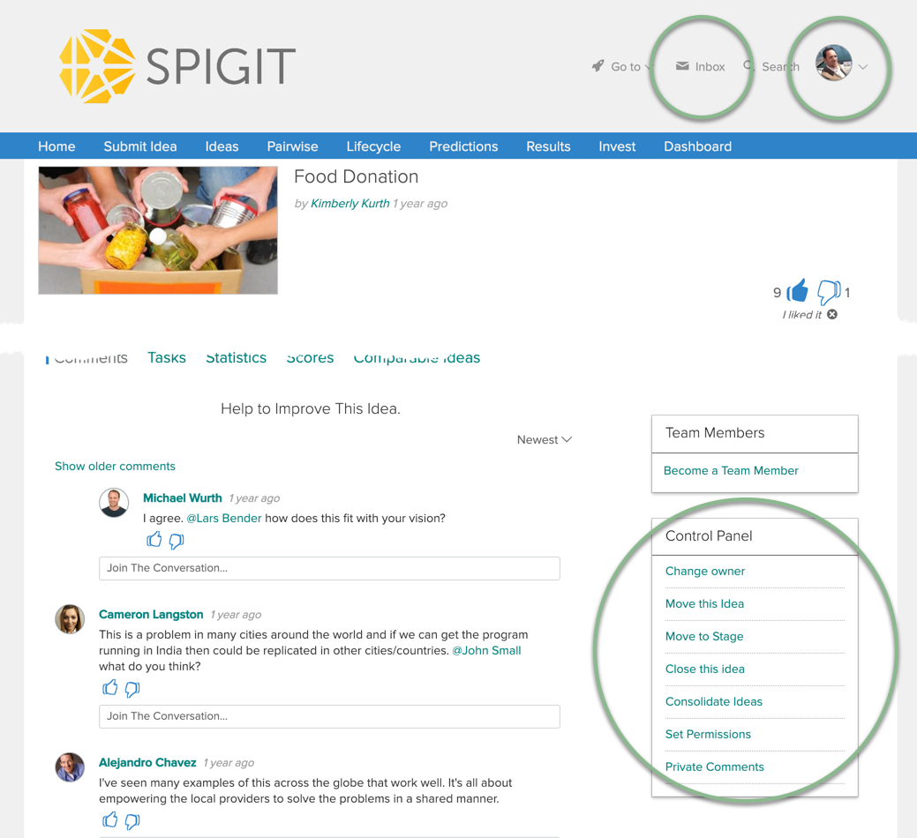
Moderation Practices
Additional tools supporting Moderation
Profile
Inbox
Control Panel
Discuss control panel options with your Challenge Lead to ensure a consistent process is followed.
Notes:
A few more tools that will help you moderate. Consider reviewing and updating your profile so that audience members know a bit about you and how to contact you outside of the platform if needed. Also, become familiar with the inbox feature, as this is where you will receive in-app notifications and any tasks that may be assigned to you. Lastly, as a moderator, you will have increased actions available on the idea page, though the control panel widget. These actions allow you to change idea owners, move ideas between challenges and stages, close or consolidate ideas, and use the private comment thread, which is only viewable by other moderators and admins.

Slide 11
Scenarios
Note: examples are fictional

Slide 12
Scenario 1: the case of the well-formed idea
The Idea
Engineering change orders for work being done at the East Bend Generating Station often arrive without notice. We learn about them seemingly by accident. This often causes the operators to redo work, using additional resources unnecessarily. What if we were to use System X to make all pending and approved change orders available to the plant staff, so they could get a sense of what’s coming down the pike?
What action might the moderator take?

Slide 13
Scenario 1: a moderator action
Pick “share” or @mention in the comments section.
Identify a potentially interested party working at another Station.
Type…
“Might the following idea might have some relevancy at the Beckjord station? Are you having similar experiences? Please review and comment when you have a chance.”

Slide 14
Scenario 2: The case of the facile response
The Idea
The contractors at Firm XYZ are unreliable. They neglect basic safety procedures. What if we were to rebid the services that Firm XYZ provides us in the hopes we can on-board a new, better service provider? Knowingly or not, Firm XYZ exposes our company and its employees to a lot of liability. This idea would mitigate that risk.
Audience Comment
Great idea! Let’s go for it ASAP!
What action might the moderator take?

Slide 15
Scenario 2: a moderator action
Pick “Join the Conversation” under the comment.
Type…
“Thank you for sharing your enthusiastic response. Please show your support by voting for this idea. Can you offer further perspective, based on your direct experience working with contractors, on why you feel this is a great idea?

Slide 16
Scenario 3: The case of a call for help
The Idea
When we start maintenance projects, it seems as if we pay a lot of attention to the near-term, but not the total, long-term cost of the work. our company is around for the long-term. What if we got the managerial accountants to look at some of our larger maintenance projects? I’ve just started learning about total cost accounting in my part-time MBA program, but I would need some help exploring the idea, fully.
What action might the moderator take?

Slide 17
Scenario 3: a moderator action
Pick “share”
Find a couple managerial accountants in the directory
Type…
“Hello, I would very much value your perspective on this idea. The contributor has an idea for improvement, but she is rather green in applying what she’s learned to the real world. What do you think?”

Slide 18
Scenario 4: the case of the duplicate idea
The Idea
When we start maintenance projects, it seems as if we pay a lot of attention to the near-term, but not the total, long-term cost of the work. our company is around for the long-term. What if we got the managerial accountants to look at some of our larger maintenance projects? I’ve just started learning about total cost accounting in my part-time MBA program, but I would need some help exploring the idea, fully.
What action might the moderator take?

Slide 19
Scenario 4: a moderator action
Pick “share” and respond to the idea owner.
Type…
“Hello, thank you for sharing your perspective. I believe your idea may be similar to <insert link to duplicate idea>. If you truly believe your idea is different from the idea above, can you please edit the idea and provide some key differentiations?
(3) Follow up…
If the contributor has second thoughts, then you can go back to the challenge team to have them consolidate ideas and work with the idea owner.

Slide 20
Scenario 5: the case of the off-topic idea
The Idea
The cafeteria at the Wabash River Station used to have pizza Fridays. I really liked the pizza. Now, there are no more pizza Fridays. Let’s bring them back!
What action might the moderator take?

Slide 21
Scenario 5: a moderator action
Pick “comment”
Type…
“Hello, thank you for sharing your perspective on the challenge question, ‘How might we maximize the likelihood that you reach your potential at work?’ Please advise – do you believe that your idea directly addresses the question in an authentic way?”
(3) Follow up…
If the contributor has second thoughts, then you can go back to the challenge team to have them delete the idea.

Slide 22
Demonstration

Slide 23
Open Question and Answer Period
Use the ‘Raise Hand’ or ‘Q&A’ feature to ask a question.

