Slide 1
Challenge Title
Moderator Training
Notes:
1) Update the logo
2) Update the Challenge title

Slide 2
Agenda
Challenge Overview
Challenge Moderation Practice
Example Scenarios
Notes:
1) Update the logo

Slide 3
Challenge Overview
Innovation Process
Notes:
Update the logo

Slide 4
Challenge Question
E.G. How might we maximize the likelihood that you reach your potential at work?
Notes:
Update the logo
Update the Challenge Question
Presentation Note: Align the team with the business opportunity and why the challenge is important to the organization/sponsor.

Slide 5
Idea Stage Gate Process
Active Stages
Closed Stages
Crowd Selection
Evaluation
Validation
Successful
Archived
All ideas begin in this stage.
Idea owners modify ideas as they receive input.
Ideas meeting graduation criteria advance.
If no activity in 45 days, ideas automatically move to archive.
An Evaluation task is assigned assigned to the category Expert.
Ideas meeting the minimum evaluation rating advance to the next stage.
If no activity in 90 days, ideas automatically move to archive.
Challenge lead identifies funding owner.
If no activity in 1,000 days, ideas automatically move to archive.
Ideas that have passed the Validation stage should be closed as “successful”.
Ideas that expire will be moved into this stage.
Ideas that are duplicates, out of scope, or will not be pursued should be closed as “archived”.
Notes:
Update any changes to the stage gate process you may have made.
Update the logo
Presentation Note: Ensure the team understands when to begin moderation and how the innovation process works.

Slide 6
Challenge Moderation Practices
Innovation Process
Notes:
Update the logo

Slide 7
Principles of Challenge Moderation
Increase
Understanding
Increase
Perspectives
Focus – Focus the audience
Catalyst – Expand the thinking
Nexus – Expand the influence
FOCUS THE AUDIENCE
Report out of scope ideas to the challenge team.
Help participants understand comments are for building, voting is for showing support.
Respond to as many ideas as possible.
EXPAND THE CONCEPT
Help the innovator increase understanding among the audience.
Help uncover opportunities for expansion in different areas or the idea/business.
What is the primary advantage of this idea over the current state?
EXPAND THE INFLUENCE
To members with related interests.
To members with valuable perspectives.
Notes:
Update the logo
Presentation Note: Out of scope ideas should be reported to the challenge team, while out of scope conversations should be appropriately challenged. Help users understand that voting is for showing support vs. comments/discussions are for idea building. E.g “Great Idea” is a nice comment but does not add much value to the idea. Respond in a timely manner to all ideas. A good moderator response is in the form of a question. The role of the moderator is to help the person who contributes and collaborates on an idea more fully realize the potential of their idea and their leadership, not to vet ideas, ad hoc.

Slide 8
Moderation Practices
View All Ideas Page
Set a goal for yourself to look at X number of ideas that have not received a lot of engagement to date (e.g., as a function of views, comments, and votes).
Notes:
Update the logo

Slide 9
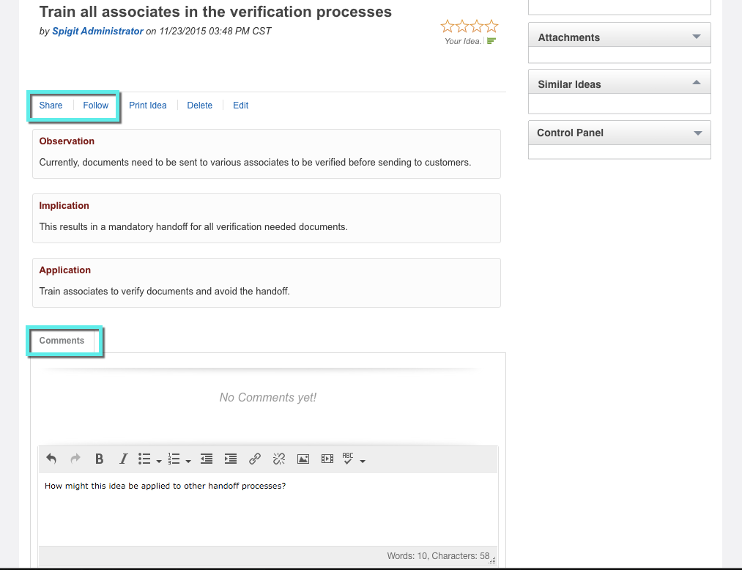
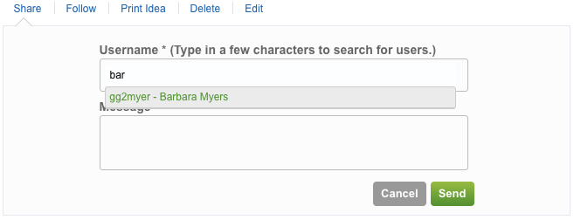
Moderation Practices
Idea Home Page
The primary tools needed for Moderation
1
2
Share
Follow
Comment
the share window…
3
Use @ mentions to notify someone
Notes:
Update the logo

Slide 10
Scenarios
Note: examples are fictional
Notes:
1) Update the logo

Slide 11
Scenario 1: the case of the well-formed idea
The Idea
Observation
Engineering change orders for work being done at the East Bend Generating Station often arrive without notice. We learn about them seemingly by accident.
Implication
The operators often have to redo work, using additional resources unnecessarily.
Application
What if we were to use System X to make all pending and approved change orders available to the plant staff, so they could get a sense of what’s coming down the pike?
Notes:
1) Update the logo

Slide 12
Scenario 1: perspective
Perspective on the idea?
What action might the moderator take?
Notes:
1) Update the logo

Slide 13
Scenario 1: a moderator action
Pick “share”
Identify an interested party working at the Beckjord Station
Type…
“Might the following idea might have some relevancy at Beckjord? Please review and comment when you have a chance.”
Notes:
1) Update the logo

Slide 14
Scenario 2: The case of the poorly received idea
The Idea
Description
The contractors at Firm XYZ are unreliable. They neglect basic safety procedures. What if we were to rebid the services that Firm XYZ provides us in the hopes we can on-board a new, better service provider?
Value
Knowingly or not, Firm XYZ exposes our company and its employees to a lot of liability. This idea would mitigate that risk.
Audience Comment
How naïve. our company never walks away from long-standing relationships with its contractors. We just have to make the best of it.
Notes:
1) Update the logo

Slide 15
Scenario 2: perspective
Perspective on the idea and comment?
What action might the moderator take?
Notes:
1) Update the logo

Slide 16
Scenario 2: a moderator action
Pick “comment”
Type…
“Thank you for sharing your perspective. Would it make sense for the idea contributor to explore our company’s contracting policies as a means of fleshing out the idea?”
Notes:
1) Update the logo

Slide 17
Scenario 3: The case of the facile response
The Idea
Description
The contractors at Firm XYZ are unreliable. They neglect basic safety procedures. What if we were to rebid the services that Firm XYZ provides us in the hopes we can on-board a new, better service provider?
Value
Knowingly or not, Firm XYZ exposes our company and its employees to a lot of liability. This idea would mitigate that risk.
Audience Comment
Great idea! Let’s go for it ASAP!
Notes:
1) Update the logo

Slide 18
Scenario 3: perspective
Perspective on the idea and comment?
What action might the moderator take?
Notes:
1) Update the logo

Slide 19
Scenario 3: a moderator action
Pick “comment”
Type…
“Thank you for sharing your enthusiastic response. Can you offer further perspective, based on your direct experience working with contractors? What is your perspective on the company’s ability to attract and retain quality providers?”
Notes:
1) Update the logo

Slide 20
Scenario 4: The case of a call for help
The Idea
Description
When we start maintenance projects, it seems as if we pay a lot of attention to the near-term, but not the total, long-term cost of the work. our company is around for the long-term. What if we got the managerial accountants to look at some of our larger maintenance projects? I’ve just started learning about total cost accounting in my part-time MBA program, but I would need some help exploring the idea, fully.
Value
Our limited view on cost modeling causes us to pay more, long term, to fix things multiple times over. If we visit the larger projects from a long term perspective, we might be able to realize some cost savings.
Notes:
1) Update the logo

Slide 21
Scenario 4: perspective
Perspective on the idea and comment?
What action might the moderator take?
Notes:
1) Update the logo

Slide 22
Scenario 4: a moderator action
Pick “share”
Find a couple managerial accountants in the directory
Type…
“Hello, I would very much value your perspective on this idea. The contributor has an idea for improvement, but she is rather green in applying what she’s learned to the real world. What do you think?”
Notes:
1) Update the logo

Slide 23
Scenario 5: the case of the off-topic idea
The Idea
Description
The cafeteria at the Wabash River Station used to have pizza Fridays. I really liked the pizza. Now, there are no more pizza Fridays. Let’s bring them back!
Value
When we stop things that employees like for no good reason, it causes employees to disengage. If we bring back pizza Friday, perhaps engagement will go back up.
Notes:
1) Update the logo

Slide 24
Scenario 5: perspective
Perspective on the idea and comment?
What action might the moderator take?
Notes:
1) Update the logo

Slide 25
Scenario 5: a moderator action
Pick “comment”
Type…
“Hello, thank you for sharing your perspective on the challenge question, ‘How might we maximize the likelihood that you reach your potential at work?’ Please advise – do you believe that your idea directly addresses the question in an authentic way?”
(3) Follow up…
If the contributor has second thoughts, then you can go back to the challenge team to have them delete the idea.
Notes:
1) Update the logo

Slide 26
Questions?
Thank You
Notes:
1) Update the logo

