Slide 1
Challenge Title
Expert Training
Notes:
1) Update the logo
2) Update the Challenge title

Slide 2
Agenda
Challenge Overview
Challenge Expert Practice
Notes:
1) Update the logo

Slide 3
Challenge Overview
Innovation Process
Notes:
Update the logo

Slide 4
Challenge Question
E.G. How might we maximize the likelihood that you reach your potential at work?
Notes:
Update the logo
Update the Challenge Question
Presentation Note: Align the team with the business opportunity and why the challenge is important to the organization/sponsor.

Slide 5
Challenge Flow
Soft Launch
Ideation & Collaboration
Ideation Closed
Expert Review
Pairwise
Selection
1/1 to 1/5
1/5 to 1/15
1/16 to 1/19
1/20 to 1/26
1/27 to 2/2
1/27 to 2/2
Selected individuals seed ideas and test site.
Participants can submit ideas, comments, and vote on other’s ideas.
Idea owners modify ideas as they receive input
Active Moderation starts
Ideas meeting graduation criteria advance
Participants can continue to comment and vote. Idea posting is disabled.
Active Moderation continues
Ideas meeting graduation criteria advance
Voting and Commenting is disabled.
Expert panel performs detailed review of ideas
Ideas meeting graduation criteria advance
Participants prioritize ideas using pairwise.
Winners and/or top ideas announced and awards distributed.
Prioritized ideas presented to sponsor/s.
Sponsor assigns next steps for incubation or implementation.
Notes:
Update the Innovation Challenge Process; phases, dates, and activities.
Update the logo
Presentation Note: Ensure the team understands when to begin moderation and how the innovation process works.

Slide 6
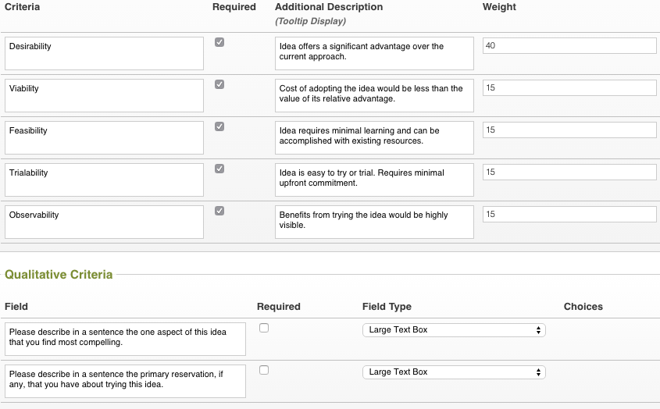
Review Criteria Alignment
Notes:
Update the Review Criteria (insert table with criteria or use a screenshot from admin->evaluation templates)
Update the logo
Presentation Note: Ensure the team is aligned on the criteria, its importance and the rating scale. Inform the team how many reviews will be performed per idea and how the scores will be used during the innovation process.

Slide 7
Challenge Expert Practices
Innovation Process
Notes:
Update the logo

Slide 8
Principles of Challenge Expert Reviews
Assess Value
Narrow
Selections
Understand the Concept
Leverage Knowledge
Be transparent
Understand the Concept
Read the entire Idea before evaluating.
Reach out to the idea owner if needed.
Leverage Knowledge
Help the sponsor, owner, and audience understand how valuable this idea might be to the organization.
Be transparent
Stay emotionally neutral when assessing.
Be honest, but professional.
Notes:
Update the logo

Slide 9
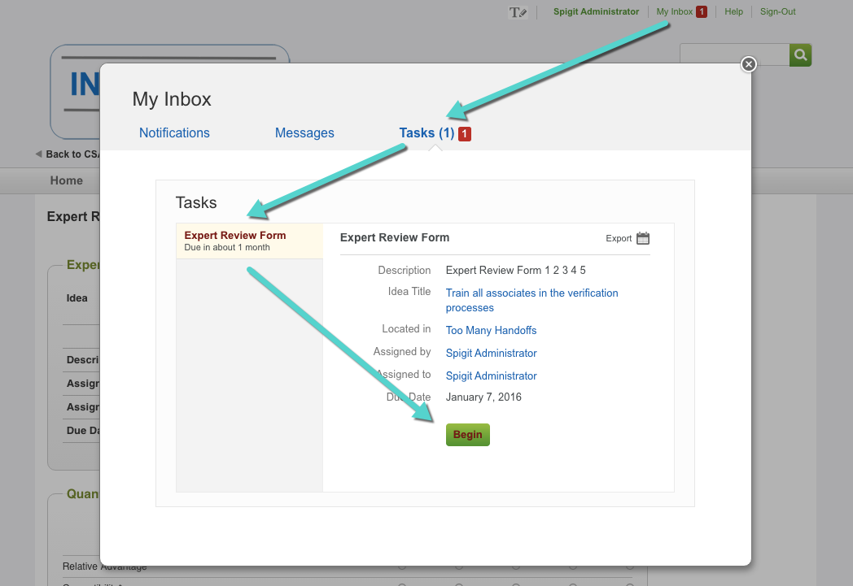
Expert Tools
The primary tools needed for Experts
Inbox
Expert Review
Share
Notes:
Update the logo
Presentation Note: Expert reviews, once assigned, can be located in the expert’s inbox (see above image). Expert reviews will be assigned by stage, not phase. The implication being that reviews will become available to the expert prior to the “Expert Review” phase.

Slide 10
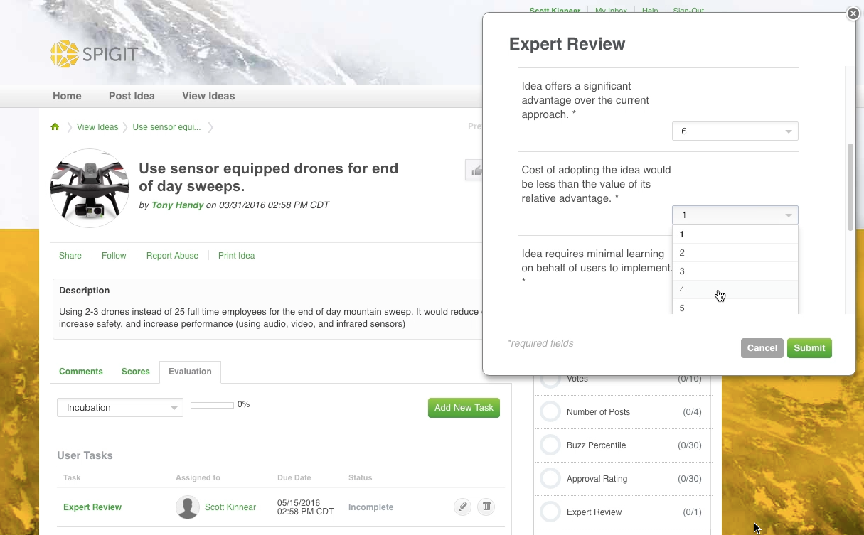
Expert Tools
The primary tools needed for Experts
Inbox
Expert Review
Share
Notes:
Update the logo
Presentation Note: Expert reviews are performed in a “Lightbox”, allowing experts to read the idea & comments while performing the review.

Slide 11
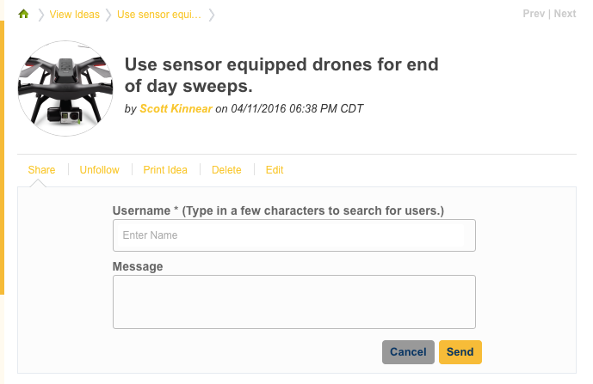
Expert Tools
The primary tools needed for Experts
Inbox
Expert Review
Share
Notes:
Update the logo
Presentation Note: If further clarification is needed, the expert can use the share feature to contact the idea owner or other participants as needed. Simply type in the name and a message. The recipient will be notified via email.

Slide 12
Questions?
Thank You
Notes:
Layout: Section Header Blue

