Slide 1
Template Slide
{Insert Release Target}
What
{explain what is being released}
{insert screen capture, or GIF or Demo as appropriate}
Why
{Explain why, and the value}
Action
{explain what action and admin needs to take to enable or use the functionality}

Slide 2
DEMO

Slide 3
Planview PPM Pro, Projectplace, and agileplace
February 2024 Update
Planview Product Management

Slide 4
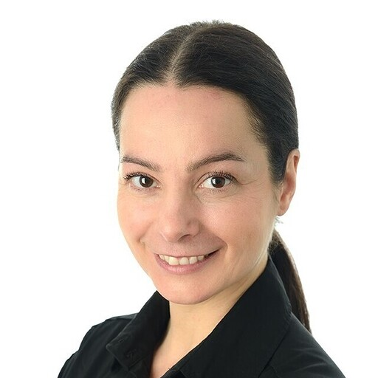
Planview Product Management Team
Silvija Doncev
Product Manager
ProjectPlace
Jon High
Senior Product Manager
AgilePlace
Paul Jacobs
VP, Product Management
Elijn Kroese
Product Manager
IdeaPlace
Mauricio Parra
Product Manager
Analytics & Reporting
Mara Puiste
VP, Product Management
Leila Rosenstråle
VP, Product Management
Ashish Sahu
Product Manager
PPM Pro
Jonathan Schnur
Product Manager
Cross Product Solutions

Slide 5
2024 Monthly Updates Schedule
PPM Pro
AgilePlace
Release Webinar
Second Wednesday of the month
Release Notes
Second Thursday of the month
General Availability (GA)
Third Friday of the month
Release Webinar
Last Thursday of the month
Release Notes
Weekly every Friday
General Availability (GA)
Continuous Delivery
ProjectPlace
IdeaPlace & TeamTap
Release Webinar
Last Thursday of the month
Release Notes
Weekly every Thursday
General Availability (GA)
Continuous Delivery (Tu,Th)
Release Webinar
Last Thursday of the month
Release Notes
Weekly every Wednesday
General Availability (GA)
Weekly every Wednesday
Coming Soon
Targeted within the next 2-3 months
Notes:
General Availability (GA) — First Thursday of the month
Webinars - Thursday before GA
Release Notes – Thursday/Friday before GA
here is a quick slide highlighting the cadence of the webinars, release notes and actual release or GA

Slide 6
What’s new
Coming soon
Announcements
Questions

Slide 7
What's New
PPM Pro
Ashish Sahu
Product Manager

Slide 8
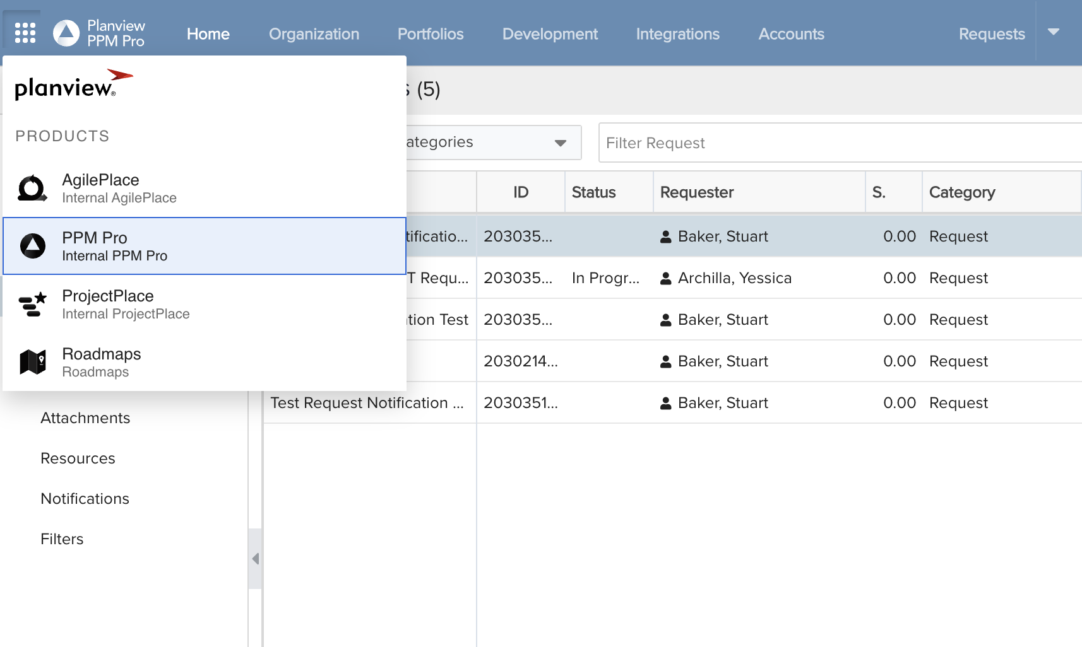
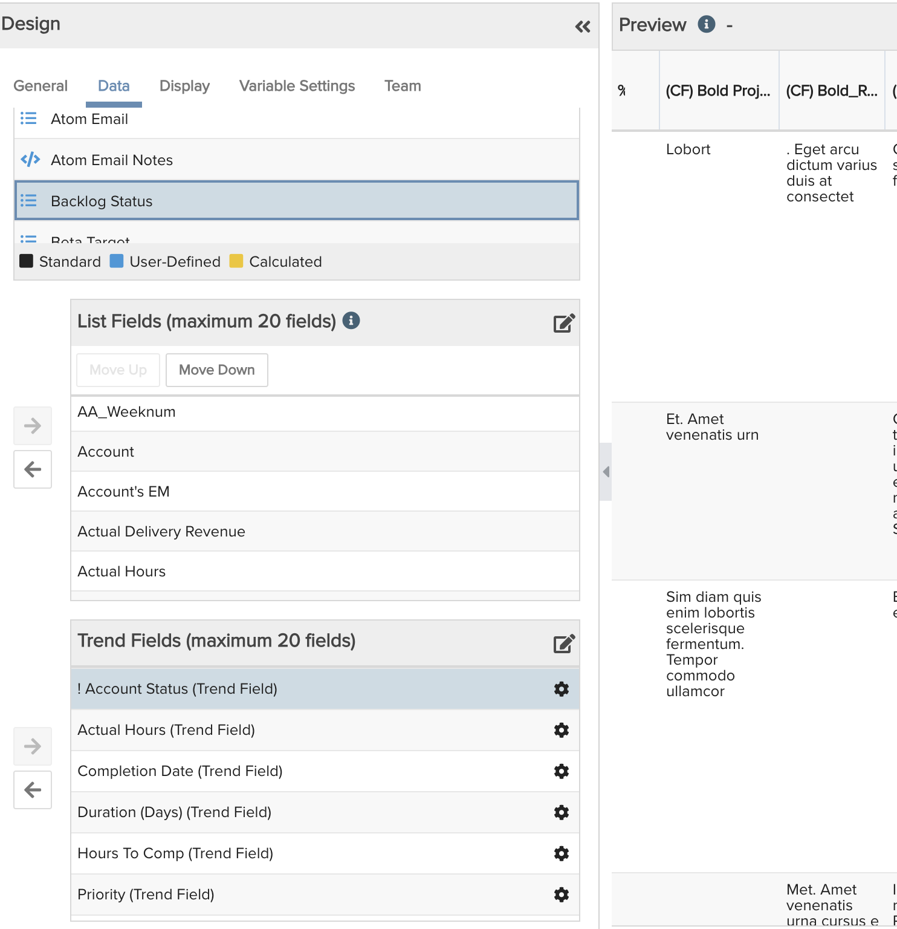
App Switcher and Trend Reports
Recap
January
What
An application switcher icon is added to the top row that shows all the subscribed applications.
Why
For customers using PV Admin and leveraging multiple Planview products, now its easier to switch between applications.
Trend Reports
For List Trend reports, the limit of Trend fields that can be added is increased to 20
How
Enabled by default if access to PV Admin is there.

Slide 9
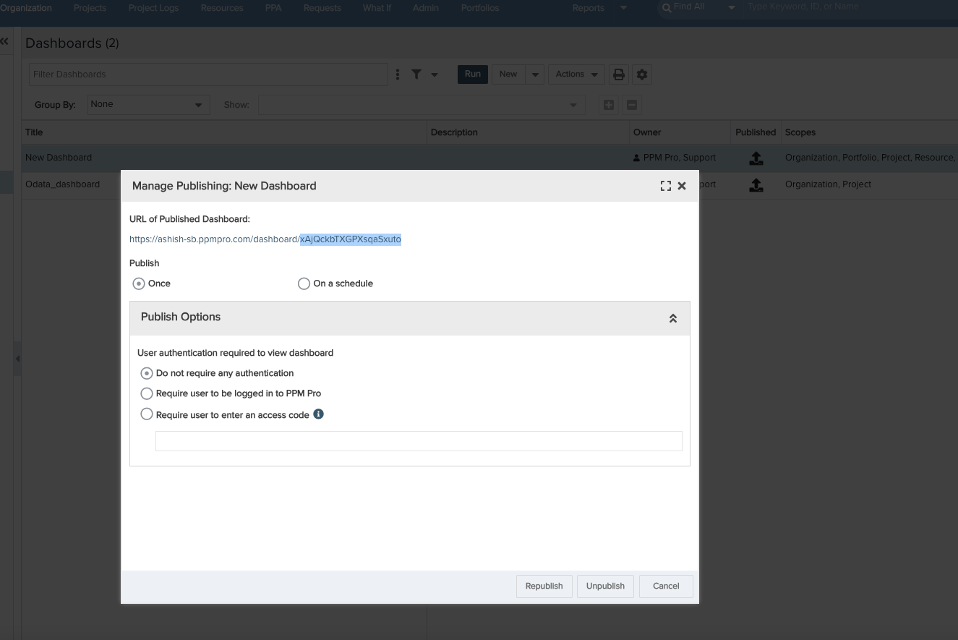
OData with R2D2
Reporting
February
What
OData is now available for new Reporting and Dashboard (R2D2).
Why
R2D2 brought with it improved performance, reliability and UX. Now OData can be leveraged to export data from R2D2 and makes it even easier compared to Legacy.
How
Enabled by default
Uses Publishing ID instead of Dashboard ID.
Notes:
DID vs PID:
PID will change if we unpublish and unpublish
If the dashboard is published from a different scope, different PID
It only works with List basic
Now same dashboards can be run in different context and you can get different results

Slide 10
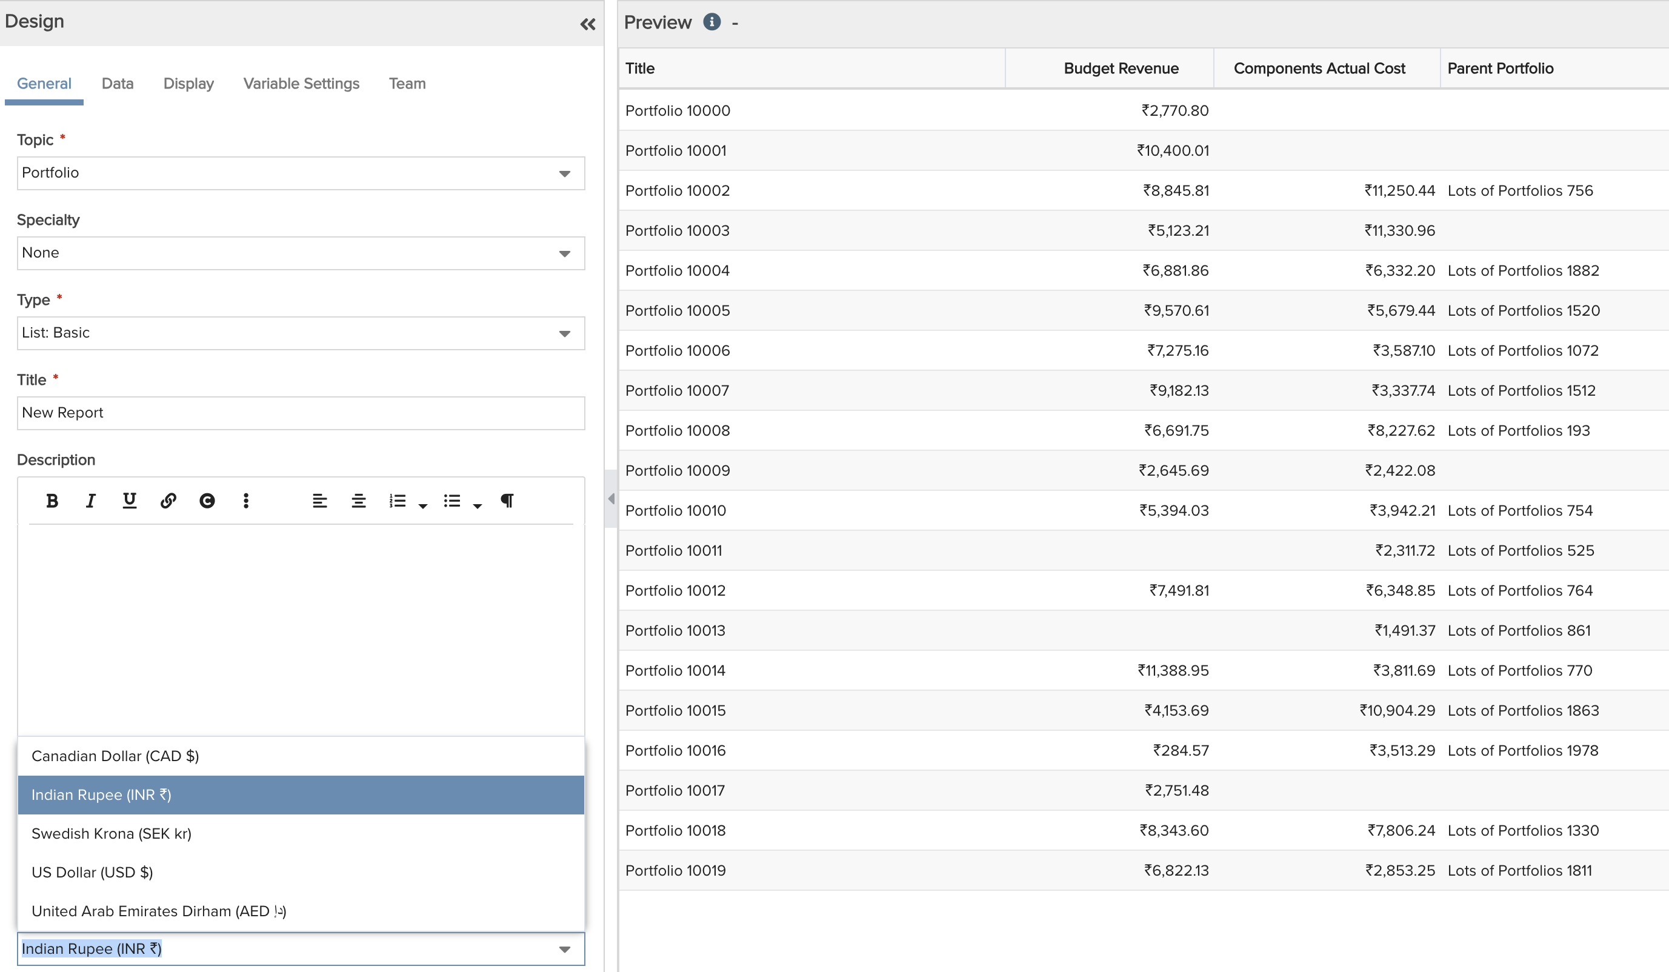
Multi Currency in Reporting
Reporting
February
What
Multi Currency conversion is now available when creating a report for portfolios topic. (Beta)
Why
Customers with Portfolios in multiple countries had to convert currencies outside of the system and made it hard to report on them.
How
Can be Enabled via feature flag (CS)
Works best with Portfolio topic and list basic fields.
Requires multi-currency to be enabled
Notes:
Works only with portfolios
Still in beta, need to be enabled via feature flag
Works best with list reports

Slide 11
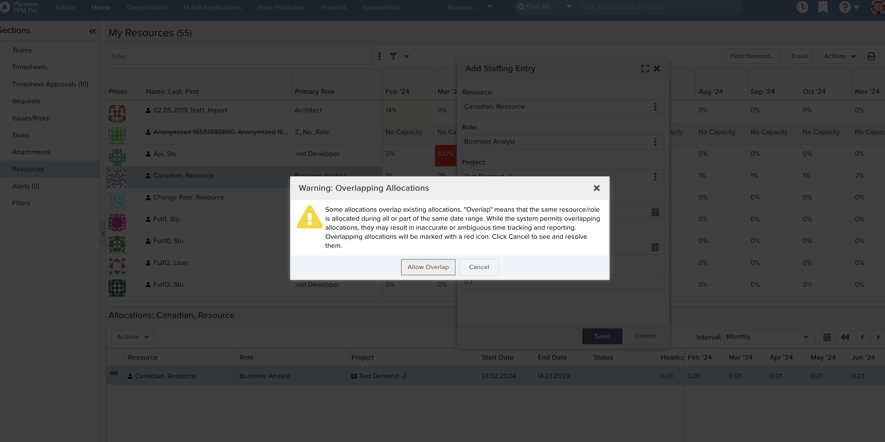
Warning for Overallocation
Resource Allocation
February
What
A warning is added if there's an overlap when trying to allocate a resource on the Resource Workbench).
Why
Previously, Project Manager could over allocate a resource unknowingly leading to rework and adjustment later
How
Enabled by default
Works Similar to project allocation warning.
Notes:
DID vs PID:
PID will change if we unpublish and unpublish
If the dashboard is published from a different scope, different PID
It only works with List basic

Slide 12
DEMO

Slide 13
Coming Soon
PPM Pro
Ashish Sahu
Product Manager

Slide 14
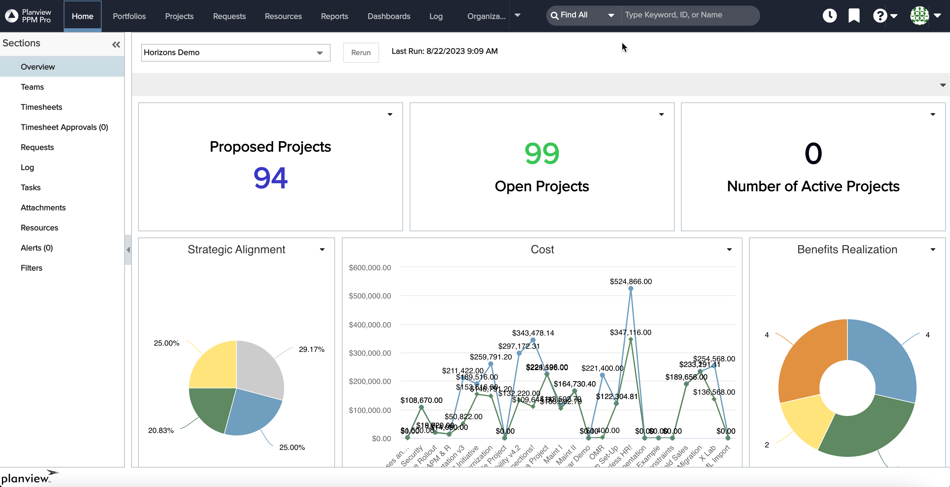
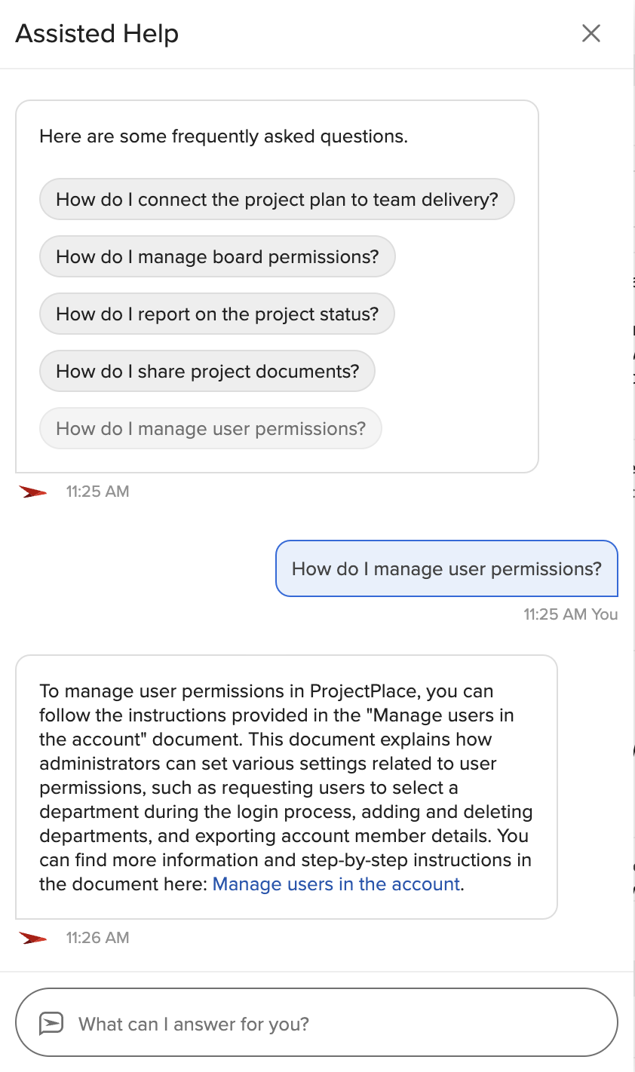
GenAI Assistant
Target: April
Generative AI based, conversational help for all user roles
Directly linked to the PPM Pro section of the Customer Success Centre, In-app help searches and summarizes answers directly to the application
Contextual and focused conversation flow that improves application usability

Slide 15
Performance and Connected Use cases
Target: 1-3 Months
Performance
Performance and stability improvements across the application.
Specially when running:
Financial summary
Financial summary reports
Historic timesheet reports
Connected Use cases
Improvements to PPM Pro – ProjectPlace integration. (V2)

Slide 16
WHAT'S NEW ProjectPlace
Silvija
Doncev
Product Manager
ProjectPlace

Slide 17
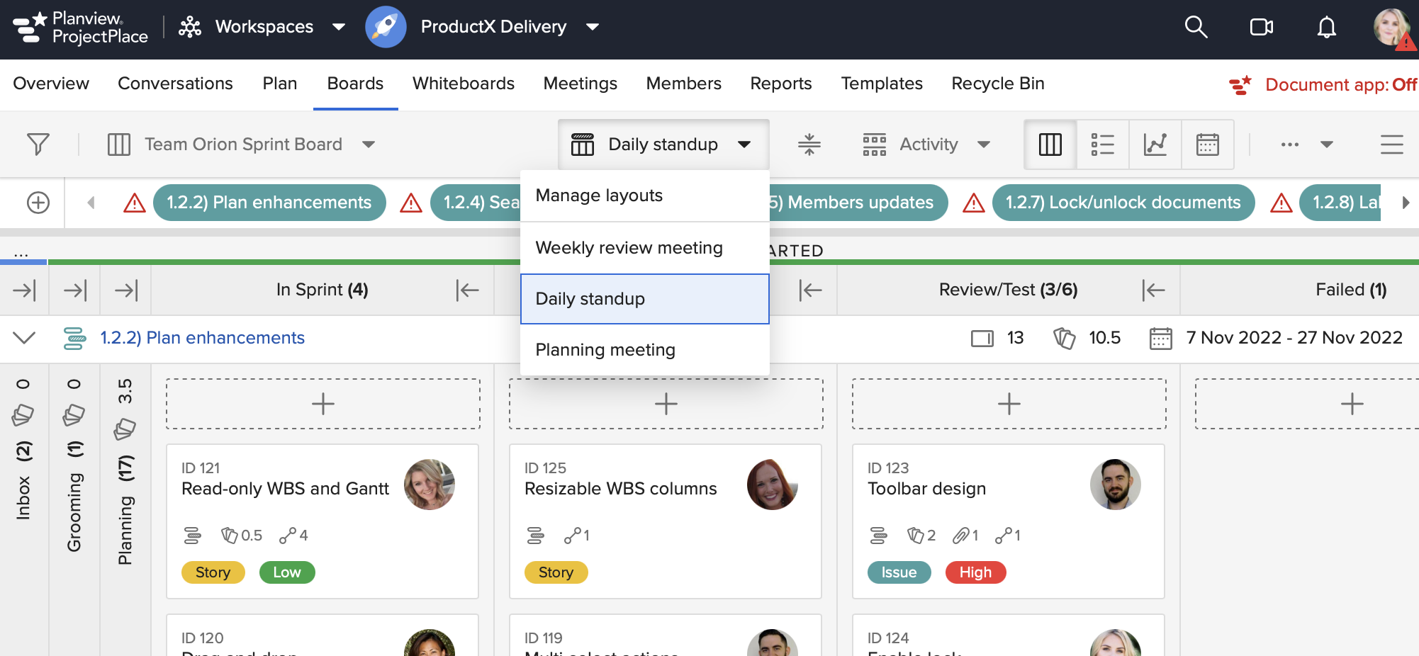
Custom Layouts for Boards
December
What
Users can create custom layouts for a board that are available to the whole team. A Custom layout will display a preferred set of columns or card grouping option with one simple click.
Why
Provides a predefined board view for convenient access when e.g. running planning meetings or daily standups

Slide 18
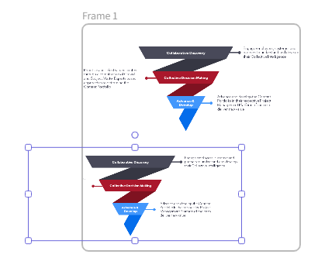
Add Frame Elements to a Whiteboard
January
What
We have added Frames as a new drawing element to Whiteboards.
Frames can be used to visually crop e.g. images to only display information within the frame
Why
To enable easy organization and visualization of content on your Whiteboard canvas

Slide 19
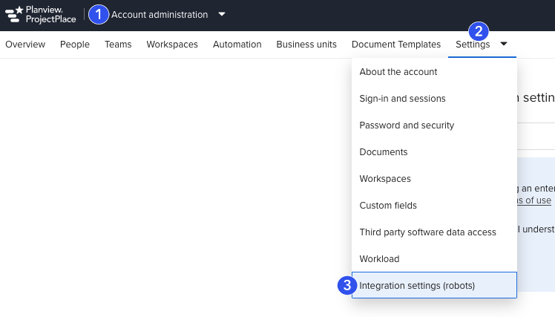
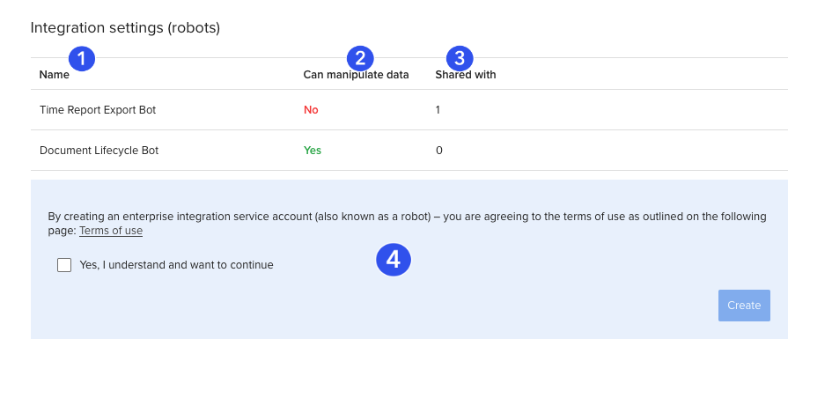
Improved Integration User Documentation
January
What
A new section in the CSC under ‘Account Administration’ (Manage Robots in the Account) with better documentation of how to manage integration user (robot) accounts
A new Integration settings (robots) page is available for Account Owners and Co-Owners that enables viewing and managing current integration user accounts
Why
To enable Account Owners to have easy access to full visibility and control of current integration user accounts settings

Slide 20
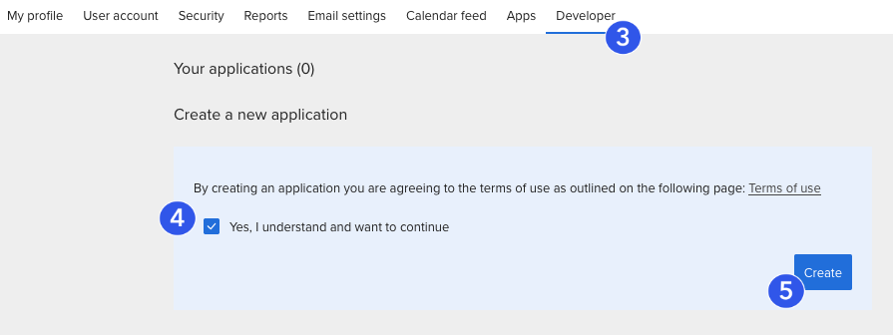
Improved Developer Documentation
January
What
A new section "Developer settings" in the CSC under ‘Manage Your User Account and Settings’ with links to resources needed for developers
A new page under user settings where user can manage application keys and tokens used for integrations and request Robot access from within ProjectPlace
Why
To support users working with integrations with better access to needed information

Slide 21
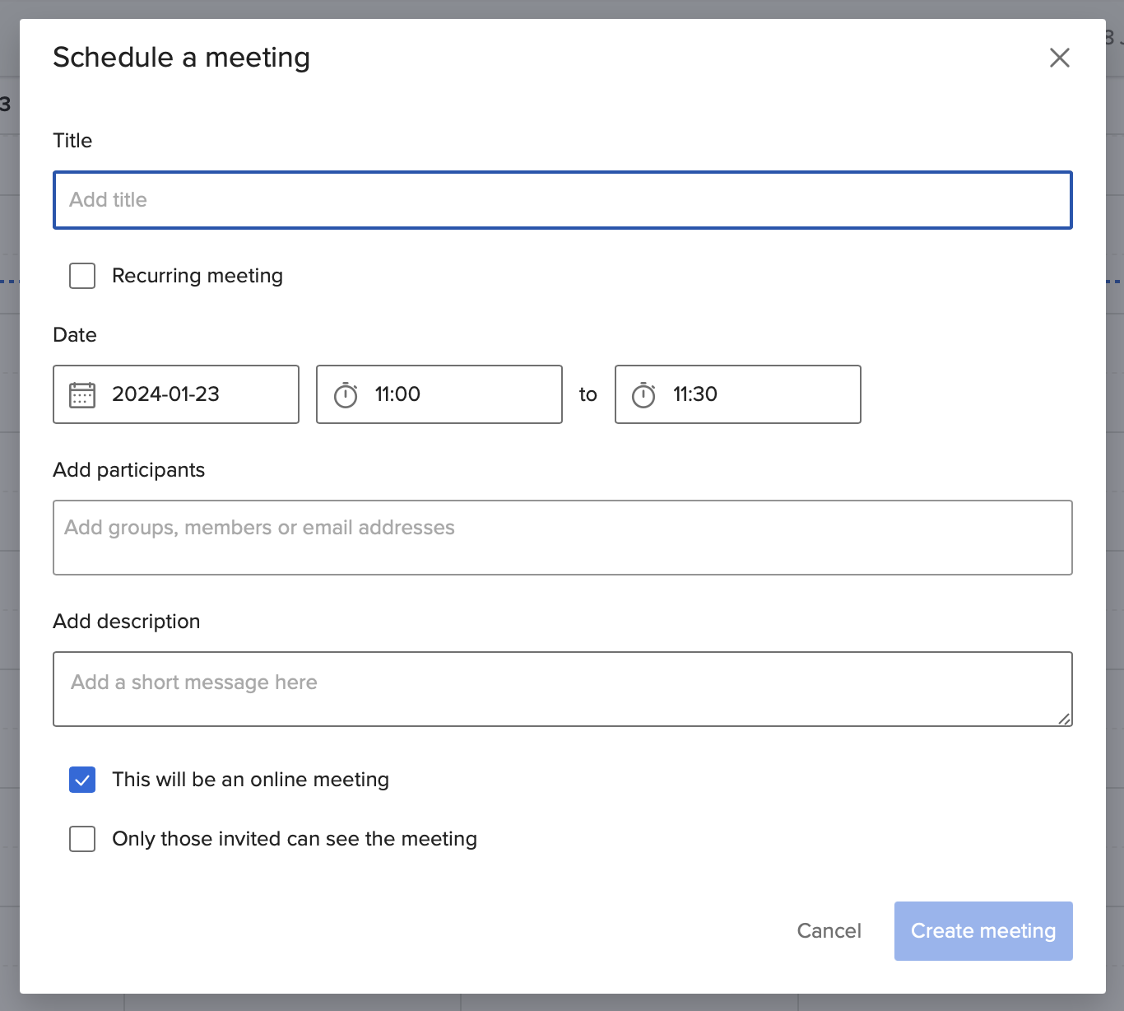
Deprecation of Zoom Online Meetings (Feb 21th)
As of February 21th, we are no longer supporting Zoom online meetings in ProjectPlace. We currently have no plans of providing a substitute service to the Zoom integration.
As of today:
Option to select online meeting in the "schedule a meeting" modal and the "video" icon in the global navigation are no longer visible.
Any scheduled online meetings after Feb 21th will be converted to in-person meetings and Zoom links will no longer work. Affected users will receive an updated meeting email between February 22nd and February 25th for all Zoom meetings scheduled on or after 21st February.

Slide 22
Coming Soon ProjectPlace
Silvija
Doncev
Product Manager
ProjectPlace

Slide 23
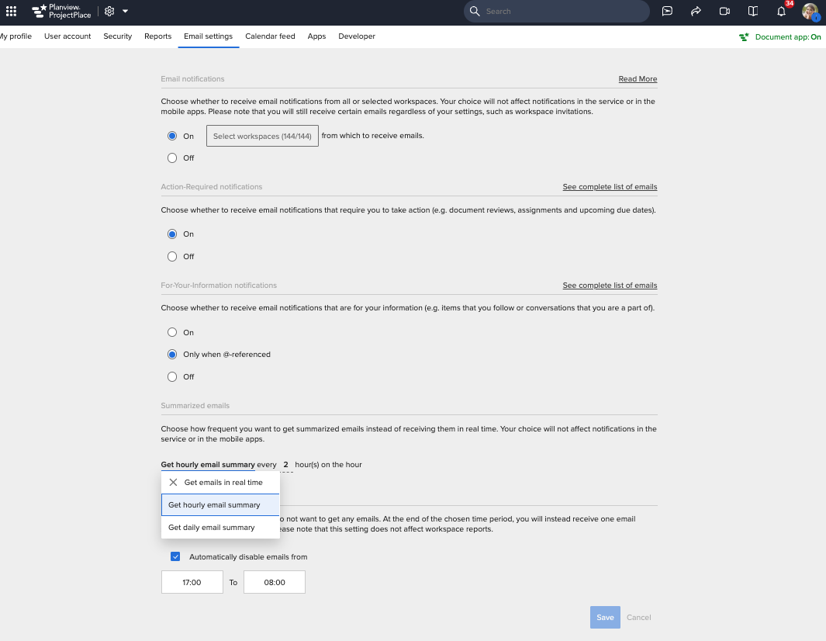
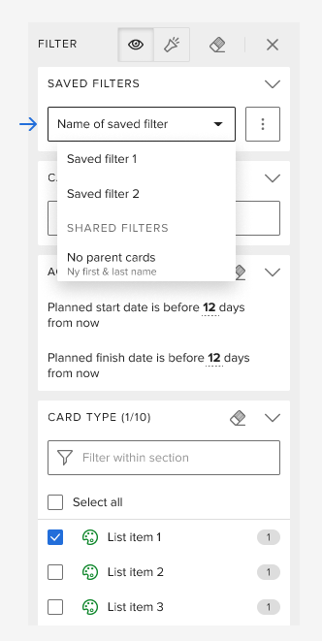
Coming Soon...
Target:
1-4 months
Save Boards filter - Target March
Set frequency of email notifications - Target March
Portfolios in ProjectPlace iOS mobile app
Teams in ProjectPlace iOS mobile app
Sentiment analysis at an activity level - Target Q2
Set frequency of email notifications
Save boards filter

Slide 24
WHAT’S NEW AgilePlace
Jon High
Sr. Product Manager
AgilePlace

Slide 25
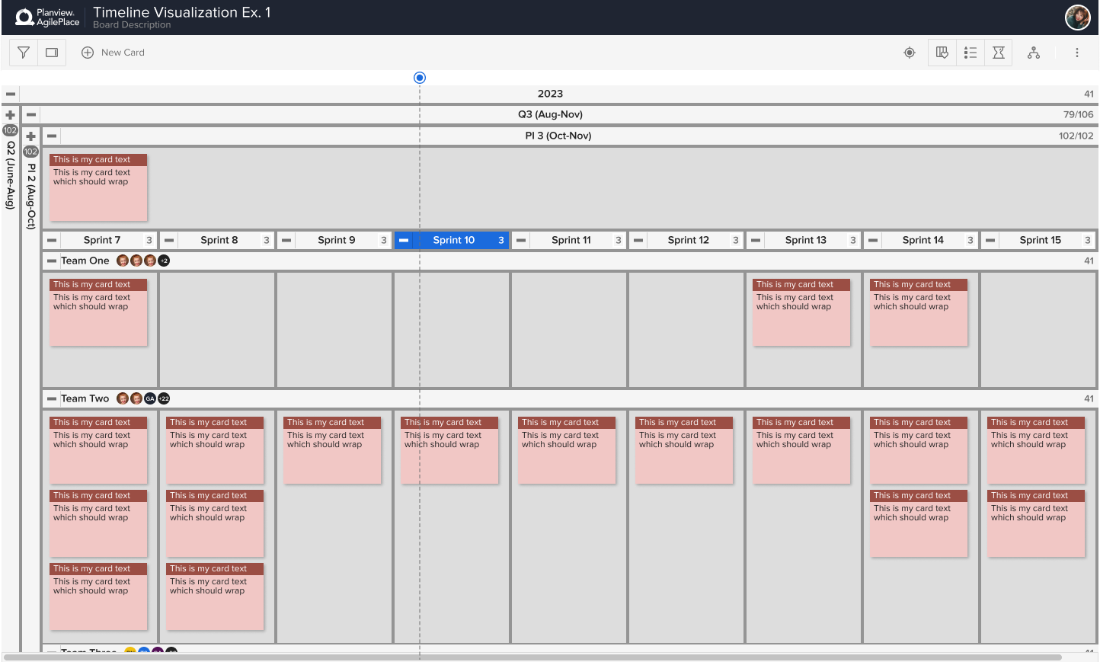
Agile Planning (Labs)
January
What
Visualize Planning Series information on a board
Enhance Planning Series experience to better support Scrum methodology
Why
Continue to improve/enhance AgilePlace’s offering for iteration-based teams and practices
Improve team’s confidence and reliability around shorter-term planning, tracking, and delivering work

Slide 26
Generative AI Capabilities (Labs)
January
What
3 use cases across Not Started, Started, and Finished lanes
What should I work on next?
Create a standup report for in progress work
Create a changelog of recently finished work
Why
Use AI to intelligently automate common use cases across the customer base
Provide early access to customers to get feedback for further workflows and use cases

Slide 27
COMING SOON AgilePlace
Jon High
Sr. Product Manager
AgilePlace

Slide 28
Custom Attributes in History
Target: Feb 2024
Updates to Custom Attribute values on the OKRs form will be reflected in the OKRs activity stream [Feb]

Slide 29
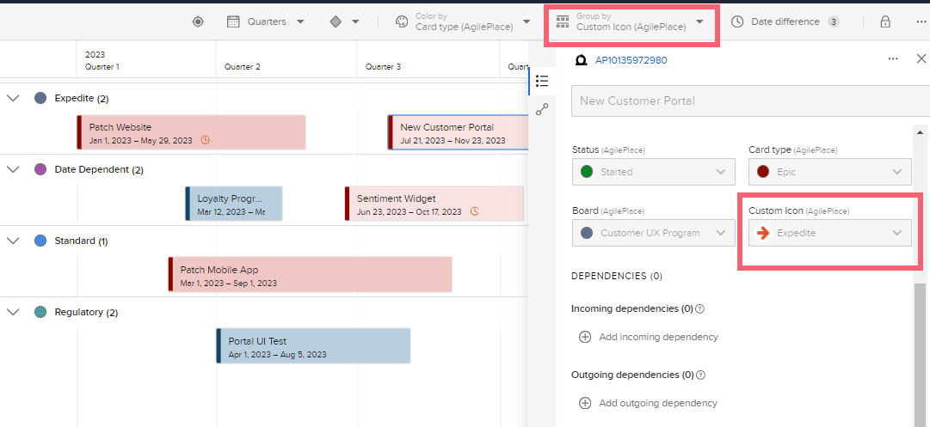
Coming Soon...
Target:
1-3 months
Planview Roadmaps for Teams
Support AgilePlace “custom icon” and “priority” attributes – Target Feb.
Expanding the number of colors available – Target March
Duplicate Roadmap – Target March

Slide 30
Announcements

Slide 31
University of Planview
Michelle Janco
Director, Global Learning

Slide 32
University of Planview
On-Demand Learning
Certifications
Badges
Enroll in Public Training Classes
And More!

Slide 33
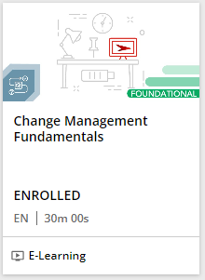
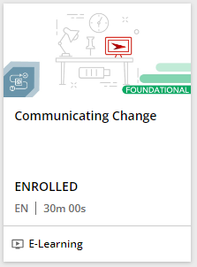
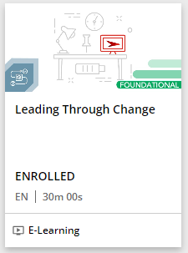
University of Planview
E-Learning
Public Training Classes
Managing Change at Your Organization
Planview PPM Pro
Managing Projects and Resources
Reporting and Dashboards
General Administration
Available
NOW!

Slide 34
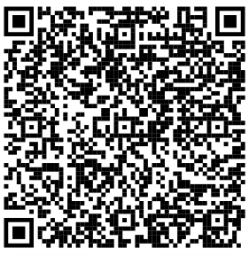
Registration available in Customer Success Center
Now Available in Labs!
Agile Planning
Generative AI – AgilePlace
Available with Feature Flag enabled
Available with Feature Flag enabled
Join us!
Provide your valuable perspective through hands on participation in one of our labs. For more information, visit the Planview Labs Program page at the Customer Success Center.

Slide 35
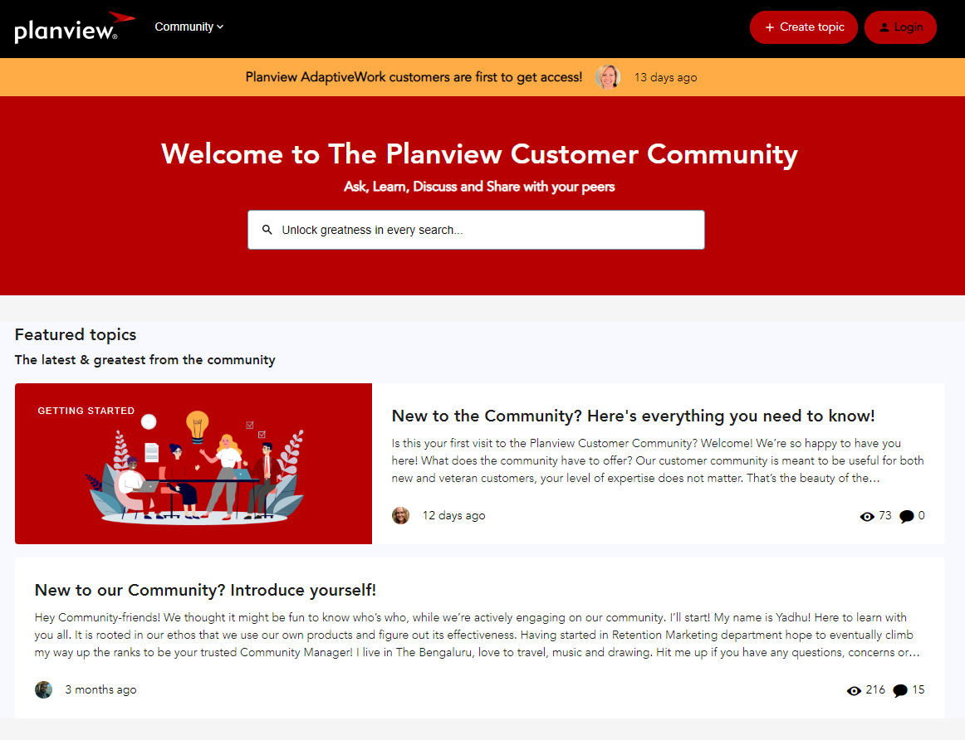
Introducing the Planview Customer Community!
A Dedicated Space to Ask, Learn, Discuss, and Share
Collaborative environment for you to engage with Planview experts and industry peers across products, industries, and locations
Community has visibility across all levels in Planview and is moderated by Customer Success to address customer queries
Keep an eye on your inbox – coming to PPM Pro and Portfolios Customers soon!
Notes:
“Building Together” is one of our core values at Planview, and building our customer community is one of the many ways we deliver on our commitment to ongoing customer engagement and success.
We are excited to bring you a platform where you can connect with other Planview customers to share real-world challenges and solutions, gain insights into best practices and use cases, and explore the path of becoming a Planview expert within your organization.

Slide 36
Questions?
Planview Labs
Join us!
Go to https://success.planview.com/webinars for more information and registration

Slide 37
Thanks!

Slide 38
Coming Soon
Objectives and Key Results
Ananya Singh
Product Manager

Slide 39
Custom Attributes in History
Target: Feb 2024
Updates to Custom Attribute values on the OKRs form will be reflected in the OKRs activity stream [Feb]

Slide 40
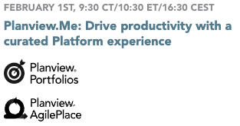
Join our Upcoming Webinars!
FEBRUARY 20TH, 9:00 CT /10:00 ET/16:00 CEST
Custom Reporting in Planview Portfolios: Strategies for Success
Registration page here!
Join us!
Go to https://success.planview.com/webinars for more information and registration

Slide 41
Inner Circle Registrations Now Open!
Analytics and Reporting
Planview.Me
Planview Copilot
Logbook (Risks & Issues)
Driving future requirements of A&R for Planview Platform
Collaborate and guide persona-driven actionable experiences
Explore how Generative AI can help you address your strategy through delivery challenges
How should risks and issues and other data be shared and accessed across products?
OKRs
Portfolios User Experience
Enterprise Architecture
Roadmapping
Driving future requirements of OKRs for Planview Platform
How can we improve the user experience in Portfolios?
How can we improve experience for Enterprise Architects?
How do you plan, visualize and share initiatives within your organization?
Team-Based Planning
Join us!
How to evolve team-level planning, assignments, and management?
Provide your valuable perspective and learn more about where we’re headed! For more information, visit the Inner Circle Program page at the Customer Success Center.

