Slide 1
Q&a challenge template

Slide 2
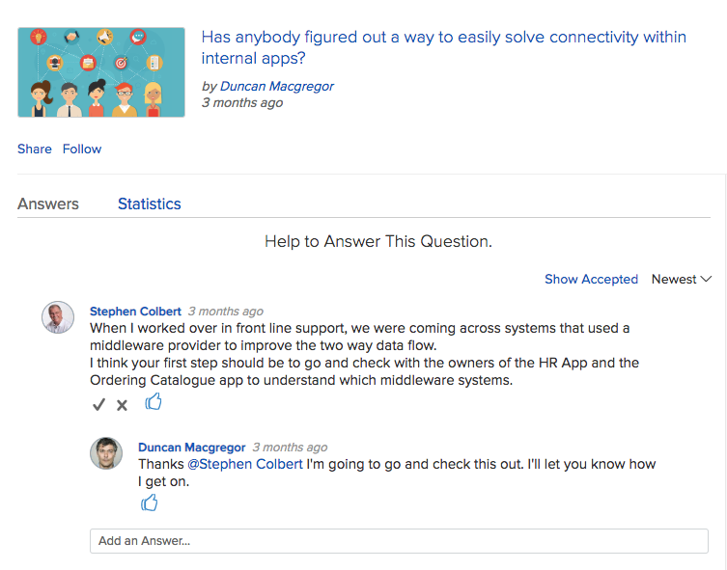
What is a Question and Answer Challenge?
The Q&A forum is a great way to tap into the corporate brain. This challenge model provides the audience with an engaging format to ask questions, get and provide answers, and build a tribal knowledge base.
ACTIVITIES
Post Questions
Edit Questions
Vote for Questions
Add Answers & Comments
Select Answers
View Selected Answers
Submission & Discussion
(Always Open)
CHALLENGE PHASE
1

Slide 3
How does it work?
Users post questions
Users vote on questions
Users add answers and comments
Question owner “Accepts” answers from available comments
Users view “Accepted” answers

Slide 4
Configuration Considerations
ONE
Update the Title, Description, URL, Phase timing and Image using the “Edit Challenge” configuration.
TWO
Update Categories using the “Edit Challenge > Settings” configuration.
three
Customize Email Notifications using the “Feature Management > Email Templates” configuration.

