Slide 1
Office Hours
Challenge Access and User Importing
Notes:
Good morning, afternoon, and evening. Welcome to IdeaPlace Office Hours, my name is ___________ , the ____________ for IdeaPlace. Today, I’m joined by _____________, responsible for ________________ at IdeaPlace. First off, thanks for taking some some to join us today, to learn about Challenge Access. Before we get started, a few housekeeping items:
First, you may ask questions using the chat or Q&A feature in the Zoom panel. Additionally, if this is a small group, we’ll open up participant audio, so you may join the discussion directly if preferred. You should be able to mute and unmute your personal lines at will - we just ask that you stay muted when not talking - to avoid background noise.

Slide 2
AGENDA
Available resources
Access Settings
Adding and Managing Users
User Attributes
Open Q&A
Notes:
The general flow of this session will be as follows: First, we’ll provide a quick reminder of IdeaPlace resources available to you, then dive into access settings and the implications there within.
Next, we’ll review how to add, import, and manage users and roles in a IdeaPlace instance. Lastly we’ll review user attributes. At the end of the short presentation, we'll open up for discussion.

Slide 3
Available Resources
IdeaPlace Learning Center
IdeaPlace Help Center & Support
IdeaPlace Professional Services
24/7 Access to online tutorials
Tutorials, Chat, and Break/fix
We’ll do it for you
Notes:
Depending on your appetite for learning, there are additional resources available such as our Learning Center - where you have 24 by 7 access to program and technical related lessons, our Help and Support center, where you can view articles, chat with our support team, and create tickets if needed, and finally our professional services team where you can simply pay us to do the work for you.
OK, let’s get started.

Slide 4
How does SSO authentication work?
Users click a link.
Your company server authenticates the users.
IdeaPlace checks for community or challenge membership.
Notes:
Before we talk about available access settings, it’s important to understand some basic concepts surrounding authentication. Most organizations choose to perform a single sign on integration, to increase both ease of use and security for employees. If you use SSO, users simply click the challenge link you send them, login to the company portal, and then IdeaPlace checks for community or challenge membership based on the access setting of the challenge or community the user originally selected.

Slide 5
How does IdeaPlace direct authentication work?
Users click a link.
Users enter a IdeaPlace username and password.
IdeaPlace checks for community or challenge membership.
Notes:
If an SSO integration does not exist, when users click the challenge link, they are presented with the IdeaPlace login page. If passed, IdeaPlace then checks for membership based on the challenge or community access setting.

Slide 6
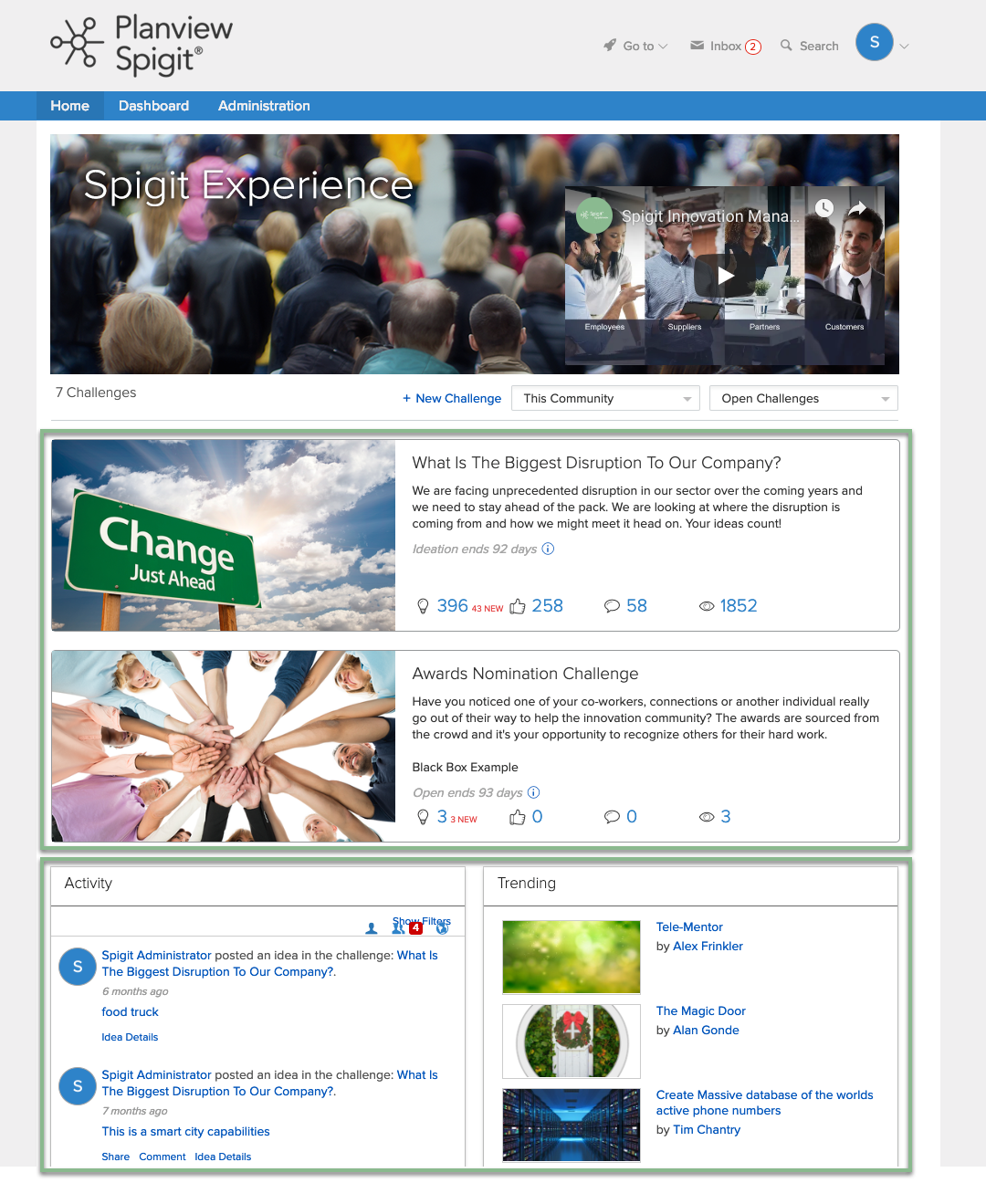
Access Settings
Can the user access the challenge or community?
What Challenges, Activity, and Content can users see when on a home community?
What email notifications will users get, when enabled for that challenge or community?
Notes:
Now let’s discuss the implications and meaning of the term access. When a user has access, also referred to as membership – to a specific challenge or community…it is implied that the authenticated user will see the challenge tile from any community, be able to navigate to the challenge itself, and view any ideas or content from that challenge.
Additionally, if a user is a member to a challenge or community, by default they will receive challenge email notifications, such as the challenge update email that is sent out every 24 hours when a new idea is posted to the challenge. These email notifications can be enabled or disabled by an administrator if desired.

Slide 7
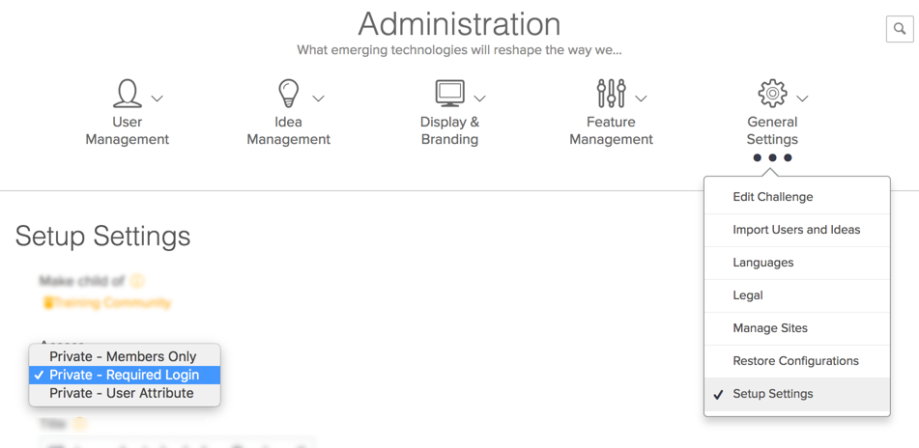
Changing Access Settings
To change how access is granted, select Setup Settings, from the General Settings page and use the Access dropdown menu.
Notes:
To change how access is granted, select Setup Settings, from the General Settings page and use the Access dropdown menu. You will see three or four options, depending on your instance configuration.

Slide 8
Access Settings
Private
Members Only
Only users with membership can access this challenge and it’s content.
Administrators can manually grant membership.
Membership is granted if new users are created from within this challenge.
Private
Required Login
All users have membership to this challenge and it’s content.
Users must authenticate with the instance first.
Membership is automatically granted if new users are created from within this challenge.
Private
User Attribute
Only users with membership can access this challenge and it’s content.
Administrators choose which User Attributes should be used when granting membership.
IdeaPlace will update access based on attribute changes.
Public
Self-Registration
All users have membership to this challenge and it’s content.
All users can view content.
Users must create a profile and user account before posting content.
Recommend using this on separate instances.
Notes:
Here are the 4 possible access settings available. Having an SSO integration will remove the public option, for security reasons. Each community and challenge is managed separately, meaning that there is not a cascading effect from one challenge or community to another.
For example, changing the access setting in a parent community, does not affect the children challenges. Starting with Private Members only:, use this setting when you want to specific which users can access the challenge and it's content.
As an administrator, you will need to grant membership, using one of the available methods we'll discuss. Next, is private required login. Use this setting when you want every user on the instance to be a member of this challenge.
Private user attribute is similar to private members only, however the system will automatically grant access based on the user attribute you specify, and hence, will take into consideration any HR changes that have taken place in your organization.
Last, is Public. This means that any user can locate and view the content of this challenge outside your organization. Most customers use this setting on a separate instance entirely, and leverage social login or a self-registration method to create users.

Slide 9
Private – Members Only
Scenario: We do not have SSO enabled. We would like to invite 20 people to an extremely sensitive challenge. How can I ensure only these 20 people can access the challenge?
Set the challenge to Private – Members Only.
Bulk remove all existing membership.
Select the individuals who need access.
Or Add users if they do not exist, and membership is automatically granted.
Notes:
I’ll review a few scenarios to consider and the actions taken to enable each.

Slide 10
Private – Members Only
Scenario: We have SSO enabled. We would like to invite 20 people to an extremely sensitive challenge. How can I ensure only these 20 people can access the challenge?
Set the challenge to Private – Members Only.
Bulk remove all existing membership.
Select the individuals who need access using the search or advanced search feature.
Or Use the user import to bulk grant access.

Slide 11
Private – Login Required
Scenario: We have SSO enabled. We would like to invite 10,000 employees to a challenge. If the other 10,000 employees access this challenge, that’s fine.
Set the challenge to Private – Login Required.

Slide 12
Private – User Attribute
Scenario: We have SSO enabled. We would like to provide challenge access to all employees with the country attribute "USA”.
Set the challenge to Private – User Attribute.
Select the “Country” attribute from the list.
Type in USA and Preview Users.
Select Update

Slide 13
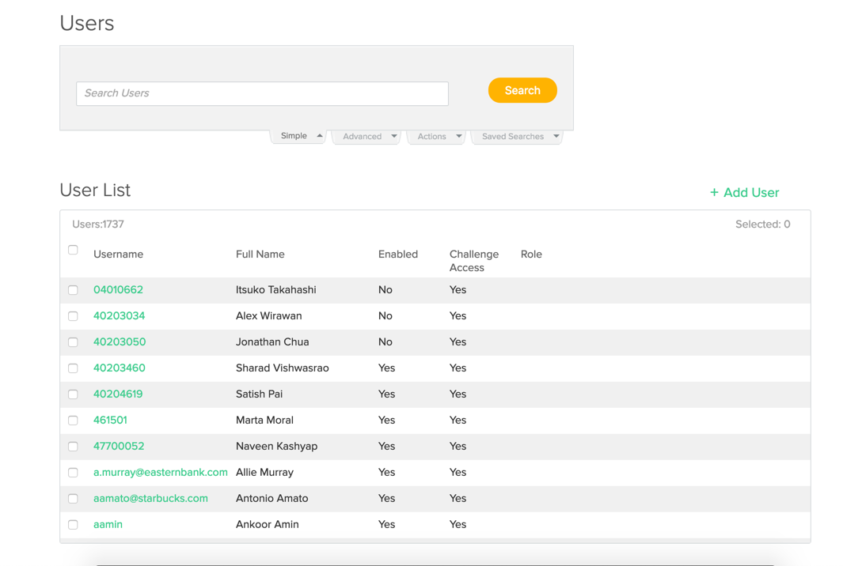
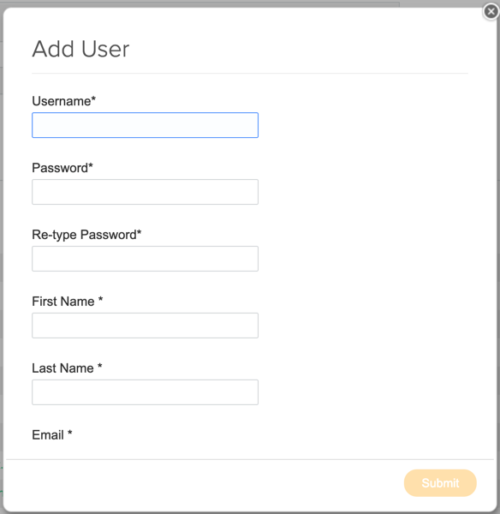
User Management
View the ”Users” panel in User Management to see who has access to a challenge.
Use the +Add User link to create a new user on the instance, with access to the current challenge or community.
Notes:
OK, so now that you can determine the right access setting, there are a number of ways to add users and manage their access.
First, if using SSO real time provisioning, which is quite standard, users are automatically created on the instance when authenticated.
Admins may also add new users to the instance by navigating to the users panel, from the user management section in administration.
When you select add user, a popup will appear and when completed does two things. First, it adds a user to the instance and second it grants access to the current community or challenge.

Slide 14
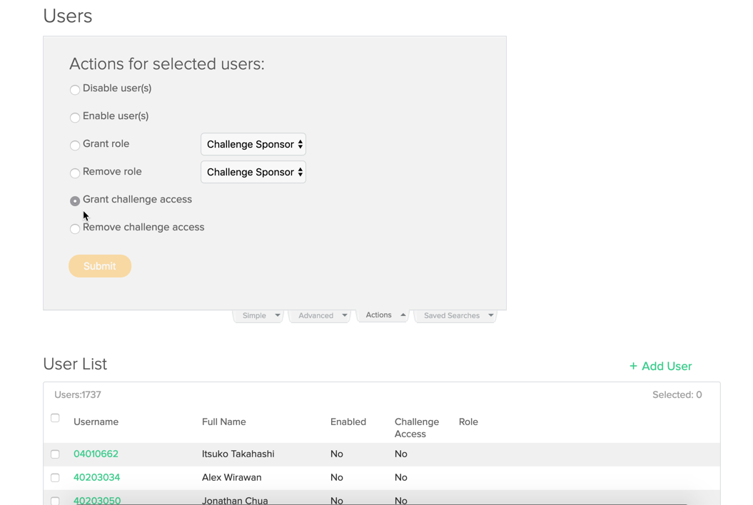
User Management
Perform actions on multiple users by selecting the users, navigating to the actions tab, and performing the desired action.
Notes:
Another way of adding users, is by selecting the checkbox next to the user and navigating to Actions, where you may grant access to all selected users.

Slide 15
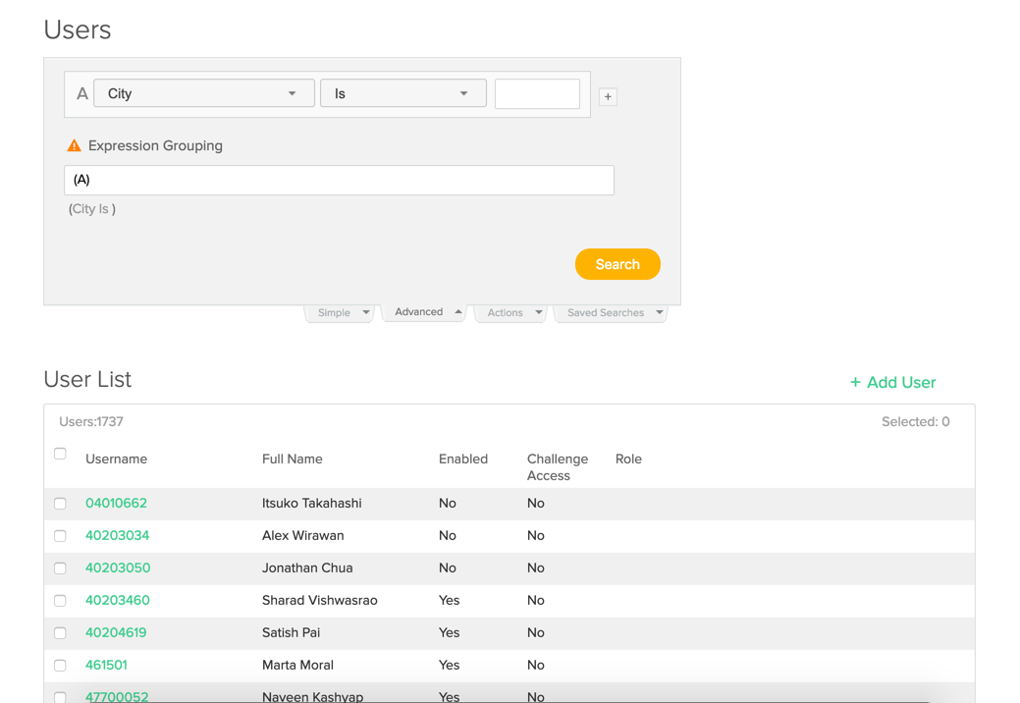
User Management
Combine the advanced search and action features to update access in bulk, when user attributes are present.
Notes:
Using the advanced search feature to locate users with a specific attribute, then selecting those users and performing an action is a great way to edit users in bulk.

Slide 16
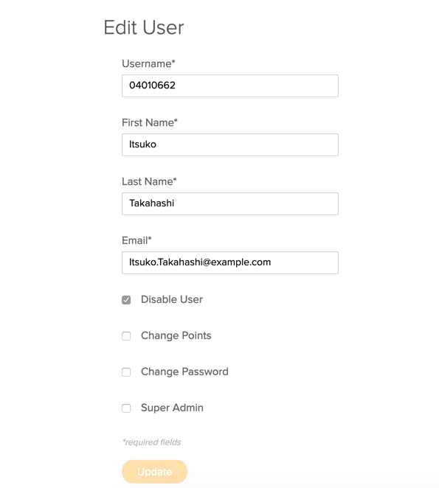
User Management
Use the Users panel to view user’s access and perform updates to names, email addresses, and roles.
Notes:
From the user panel, you can quickly see if a user is enabled or disabled on the instance, if he or she has access to the current community or challenge, and any roles they may have, with the exception of the moderator, expert, and super admin. When you select a username, you may edit their information directly and modify any available roles with the exception of moderator and expert.

Slide 17
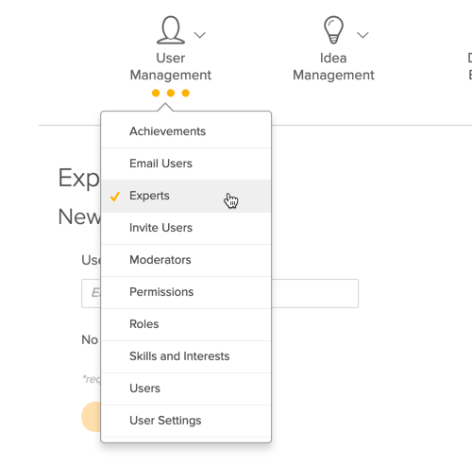
User Management
Create custom roles and add Moderators and Experts using the relative administrative panels under User Management.
Custom Roles
Allow for special permissions & access rights. Created in the Roles Panel, assigned in the User Panel.
Moderator and Expert Roles
Allows for automated tasks based on categories. Assigned in the Moderator and Expert Panel.
Notes:
To create custom roles that show up in the user panel, or to add the two special roles moderator and expert, use these options, available in the user management section of the admin panel.

Slide 18
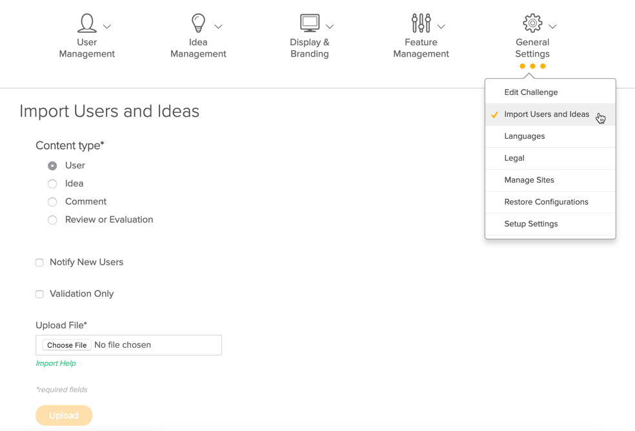
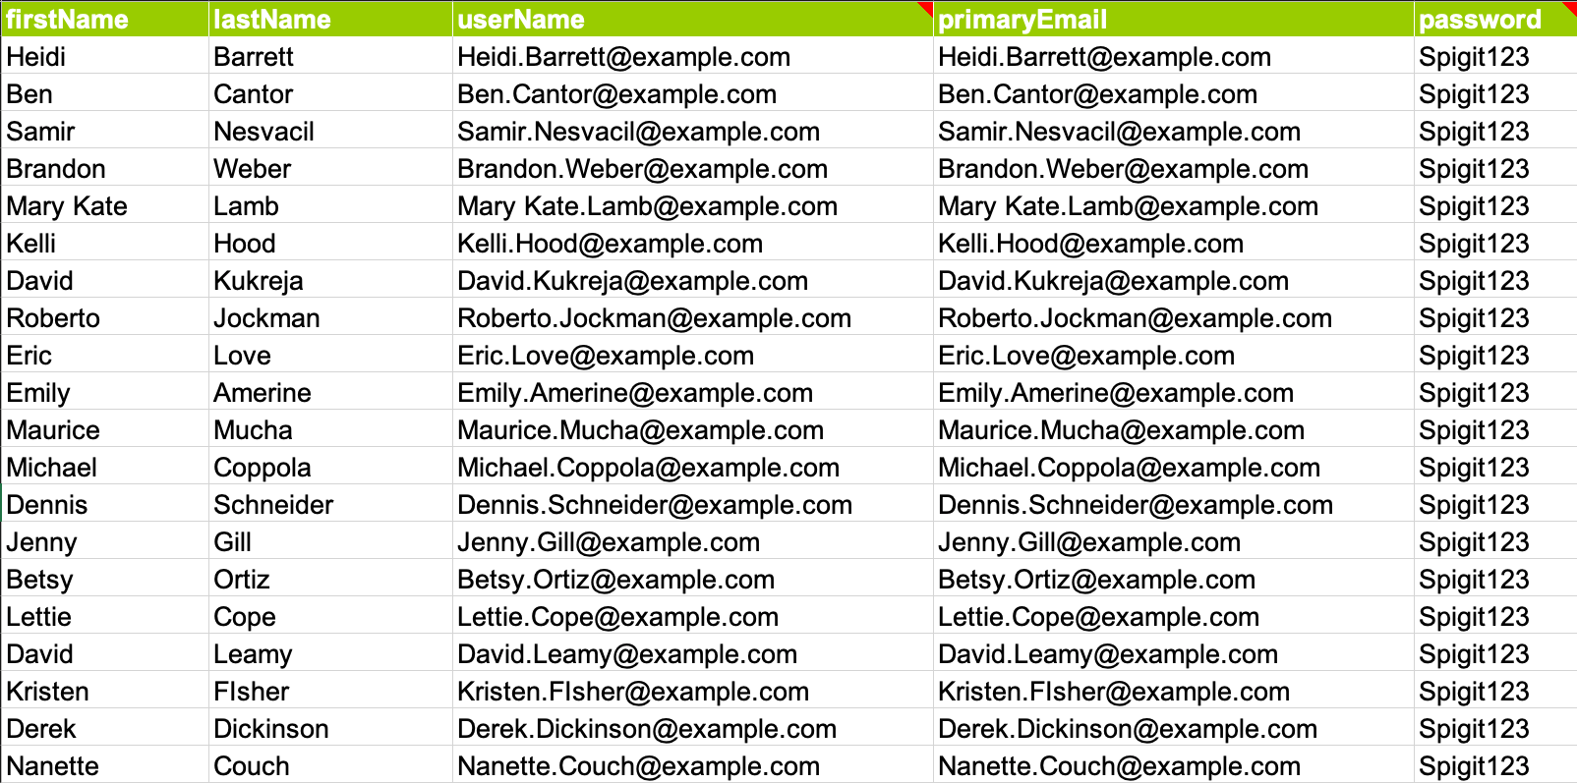
Importing Users
Use the Import User feature to quickly add users to an instance and/or grant access to a challenge quickly.
Notes:
The final method used for adding users to an instance and granting access is the user import. To import users, first complete the import spreadsheet, which can be downloaded from the help center.
Once the default fields are populated, such as first and last name, username and email. navigate to the import feature from general settings.
Select the content type of “user” and locate the excel file. Hit upload. When you use this feature, there are a few things that need to be considered. Firstly, ensure that your spreadsheet is free of errors, like extra spaces or characters.
Also, be sure the header row, or row 1, has the database name populated with exact syntax. If you need a list of available attribute database names, please contact our support team.
Also, since this is a way to grant membership to a challenge as well as add users to the instance, if existing users are in IdeaPlace and you simply want to grant access – the username and email addresses must match exactly.

Slide 19
User Attributes
.
USER ATTRIBUTE
A user attribute is a quality or feature regarded as a characteristic part of a user's profile.
Example: Name: Jack Brook
Attributes: Location – San Francisco; Company – IdeaPlace; Department – Customer Success; Position – Technical Account Specialist
Notes:
The last topic for this section is user attributes. User attributes can be defined as a quality or feature regarded as a characteristic part of a user's profile. For Example the user Jack Brook has the following user attributes: Location – San Francisco; Company – IdeaPlace; Department – Customer Success; Position – Technical Account Specialist

Slide 20
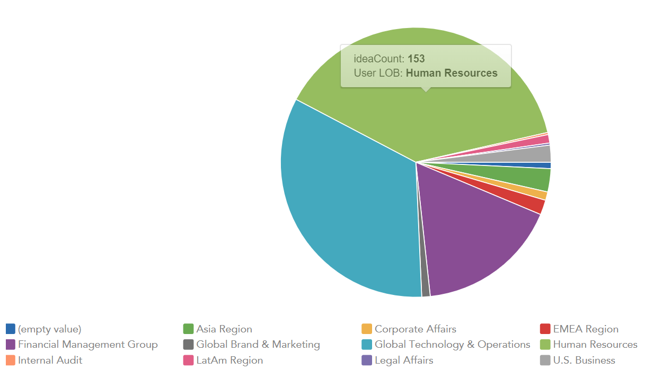
User Attributes
User Attributes can be used to better understand participation, target communications, support incentive and recognition programs, and drive insights within your program.
Notes:
We were noticing a large amount of time was being spent

Slide 21
User Attributes
.
TWO METHODS ATTRIBUTES ARE ENTERED INTO IdeaPlace
SSO – A SSO integration is made between IdeaPlace and your IT team, where attributes are being shared with IdeaPlace. As long as your team is maintaining the attributes in your Active Directory or internal system, the user’s information will be updated when they log into IdeaPlace.
User Import– You can add attributes to the user import excel file. A ticket will have to be entered into IdeaPlace Support, so the attribute fields can be built out on the backend and mapped when you complete your upload. Unlike SSO this will not automatically update per user login. You will have to maintain a current state by updating your document and re-uploading.
Notes:
Read the slide.

Slide 22
Open Question and Answer Period
Use the ‘Raise Hand’ or ‘Q&A’ feature to ask a question.
Notes:
This concludes the presentation for today's session. Please feel free to unmute your line or ask any questions using the chat and Q&A features.

