Slide 1
Maximizing Value with PPM Pro:PPMPro to AGileplace
Rob Gatch, Senior Engagement Manager
Notes:
For any non-PSA opportunities --- Use This Slide for Intro

Slide 2
Purpose of Webinar
This session is intended to inform, educate and demonstrate how you can utilize PPMPro for project planning phases and AgilePlace for the execution phases. Key to successful agile/project management is using the right tools for the right job, in order to bring the most value back to your organization
Notes:
For PSA Opportunities --- Use This Intro Slide for Intro

Slide 3
Agenda
Common Challenges​
V2 Connector
Key Takeaways​
Q&A
Notes:
For PSA Opportunities --- Use This Intro Slide for Intro

Slide 4
Common Challenges
Ensure assigned resource emails are the same in PPMPro and AP
Card titles limited to 64 characters in AP, 80 in PPMPro
Moving cards from one board to another causes custom data to not transfer
Ensure your data mappings are setup between PPMPro and AP
Notes:
For PSA Opportunities --- Use This Intro Slide for Intro

Slide 5
Overview of Integration
The relationship between PPM Pro and AgilePlace allows you to create work in PPM Pro or AgilePlace, bi-directionally synchronize and manage that work, and report out on that work in PPM Pro. Key to successful agile management is using the right tools for the right job - tools that are flexible and can evolve as you hone your processes.
PPM Pro and AgilePlace work together at the project/task/issue and card levels
Work can be created in either PPMPro and sent to AP or AP and sent to PPMPro
Notes:
For PSA Opportunities --- Use This Intro Slide for Intro

Slide 6
Setup Workflow
Following steps are necessary to setup the integration
Setup initial Sync
Identify/Create AP card types and populate PPMPro Lookup List
Configure Entity categories
Map fields
Identify/Create PPMPro Project template
Configure AP board/Enable Work Creationg
Notes:
For PSA Opportunities --- Use This Intro Slide for Intro

Slide 7
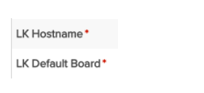
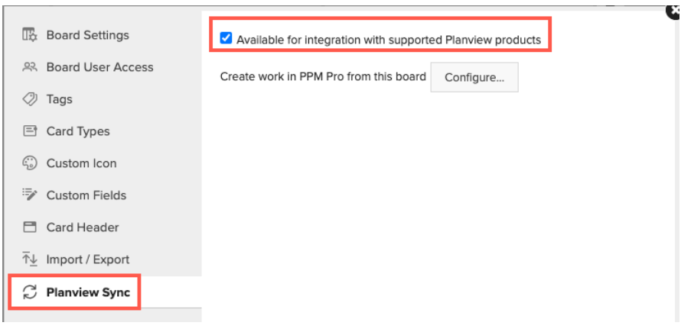
Setup initial sync
First thing is to give PPMPro the AP hostname and Default board
Then go to AP, board settings.
Notes:
For PSA Opportunities --- Use This Intro Slide for Intro

Slide 8
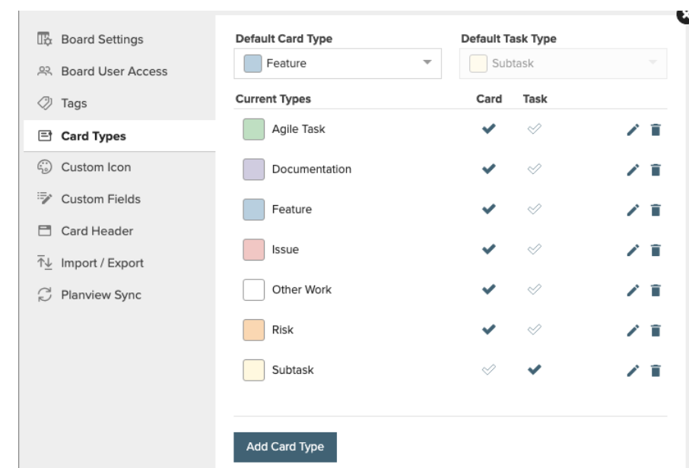
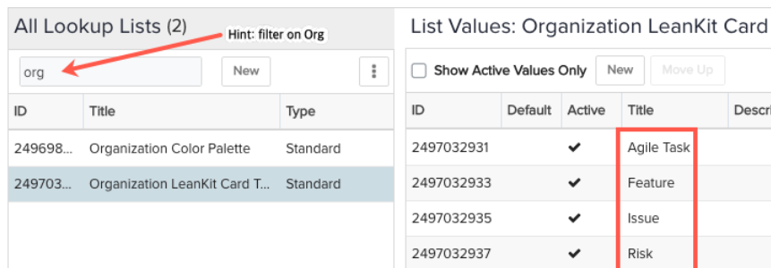
Identify/Create AgilePlace Card Types and Populate PPM Pro Lookup List
In AP, navigate to card types on your board under board settings.
Then in PPMPro define the card types you want to use between the two.
Notes:
For PSA Opportunities --- Use This Intro Slide for Intro

Slide 9
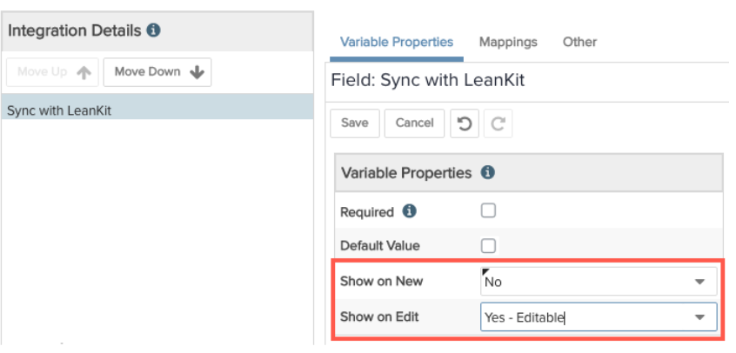
Configure Entity Categories ( Default AP Card types)
Navigate to Admin/Setup/All Entities/Projects/Categories and take a look at the list of categories. Decide whether to use an existing category or create a new oneThen in PPMPro define the card types you want to use between the two.
Edit the category and select a value for the LK Default Card Type field you want to assign to projects of this category
Ensure you add the “sync to AP”field and add it to your category you want to use for the integration whether it be a project, task or project log category
Notes:
For PSA Opportunities --- Use This Intro Slide for Intro

Slide 10
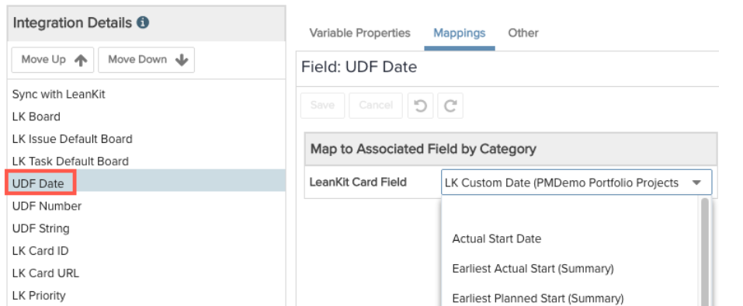
Map Fields
Add PPMPro Standard LK and user defined fields to your details page of your project, task or log.
Certain fields will be “auto mapped” by PPMPro
PPMPro fields are mappable to AP fields of the same date type. Some common fields are:
PPM Pro String field such as "Problem Description" mapped to the AgilePlace "Description" field
PPM Pro standard Date field "Start Date" mapped to the AgilePlace "Planned Start Date" field
PPM Pro standard Date field "Target Date" mapped to the AgilePlace "Planned Finish Date" field
PPM Pro standard Date field "Complete Date" (or "Completion Date") mapped to the AgilePlace "Actual Finish Date" field
Notes:
For PSA Opportunities --- Use This Intro Slide for Intro

Slide 11
Identify/Create ppmpro project template
If you plan to support work creation or creating a PPM Pro project from within AgilePlace, you'll need to have at least one project template. You can create a PPM Pro project template for the integration just as you would any other template: the template should define the project elements, such as sections, tasks, project logs/issues, and so on, that are the foundation for any instantiated projects. And don't forget to enable the "Can Be Template" property usually located in the Settings section.
You'll need to go into PPM Pro and get the ID of the project template you want to use when creating projects from AgilePlace. You can find the project ID either by opening the project template and copying the ID from the Details section, or selecting the project in the Projects list and using the ID inspector (from the Help menu, choose Developer Tools > ID Inspector to display a nameless modal). Click the project in the grid, and the ID will appear in the modal. Copy the ID to your clipboard.
Notes:
For PSA Opportunities --- Use This Intro Slide for Intro

Slide 12
Configure AP board/enable work creation
To enable work creation, you'll create a relationship between an AgilePlace lane, a supported card type, and a PPM Pro project template.
Select an included card type (the same card type defined in the project template category in PPM Pro - in this example, Feature).
Select the lane you wish to enable to trigger creation of the associated project - in the screenshot below the lane is "Doing Now". Creation is triggered when an AgilePlace card is created or moved into this lane.
Enter the Project Template ID (see note at top of this section) that matches the selected Included Card type. For example, when the Project Card Type is is dropped into the Doing Now lane, it generates a project for the corresponding template (identified by ID) which has a Default Card Type that matches the selected card type (Project). There can be multiple included card types, each associated with a project template with the matching Default AgilePlace Card type. As configured in the screenshot below, when a card is dropped in the Doing Now lane or the Under Review lane, a project is created based on the associated template.
Notes:
For PSA Opportunities --- Use This Intro Slide for Intro

Slide 13
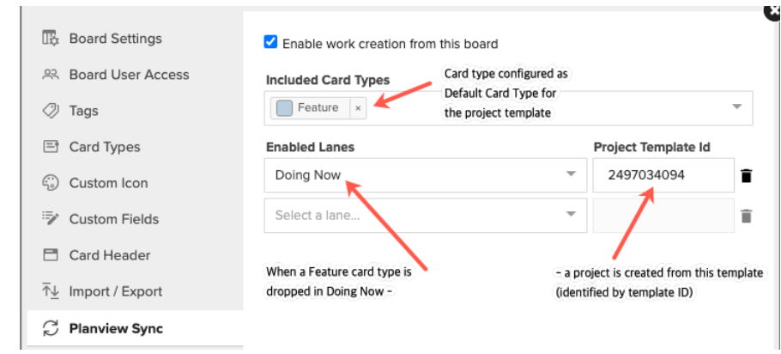
Configure AP board/enable work creation
Notes:
For PSA Opportunities --- Use This Intro Slide for Intro

Slide 14
Key Takeaways
Ensure you submit a support ticket to get the integration turned on
Define the work you want to move between PPMPro and AP
Map your fields, and define the boards you are using in AP and the card types/entities.
MAKE YOUR MOVE
Notes:
For PSA Opportunities --- Use This Intro Slide for Intro

Slide 15
Thank You
Rob Gatch, Senior Engagement Manager

