Slide 1
“The Connected Experience” PPMPro-PP Connector

Slide 2
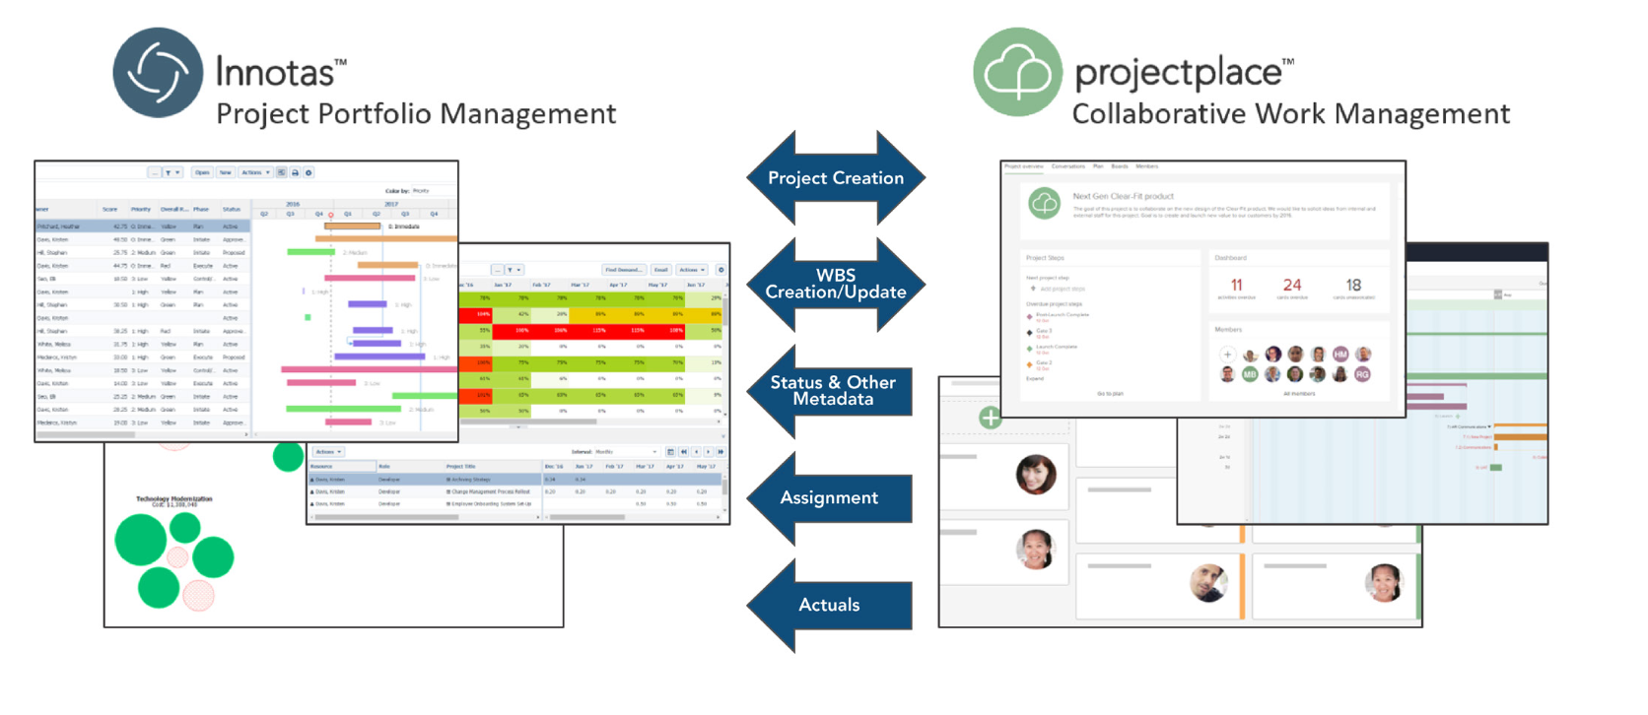
PPMPro + Projectplace: PPM and Work Collaboration for All Project Types and Resources
Notes:
One portfolio, multiple execution solutions
Complete picture of resources and work
Collaborative work management for PMO-driven projects

Slide 3
Projectplace – PPMPro Integration
PPMPro
Projectplace
Work
Work
Project Creation
Project
Project
Summary Tasks
WBS Creation/Update
Activity
Status and other metadata
Tasks/Activities/
Milestones
Milestones
Activity
Assignment
Rolled-up to leaf
Assignments against Leaf
Card Assignments
Actuals
Timesheets
Activity Time

Slide 4
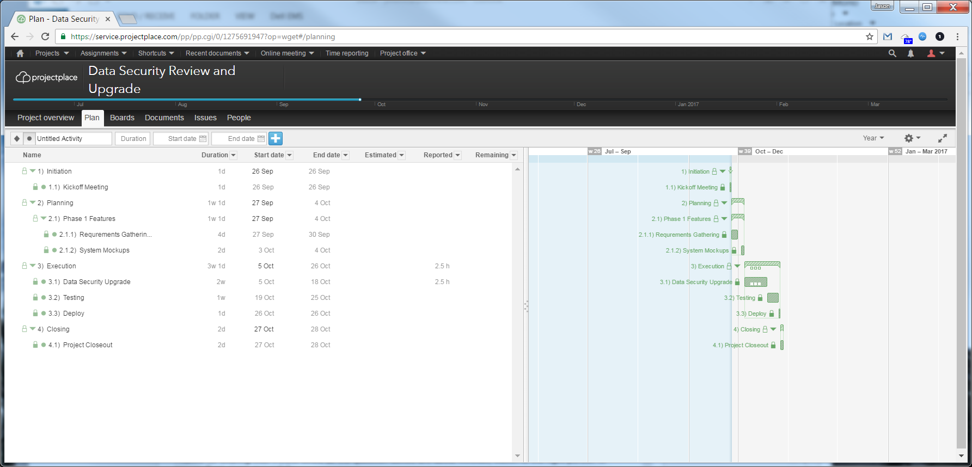
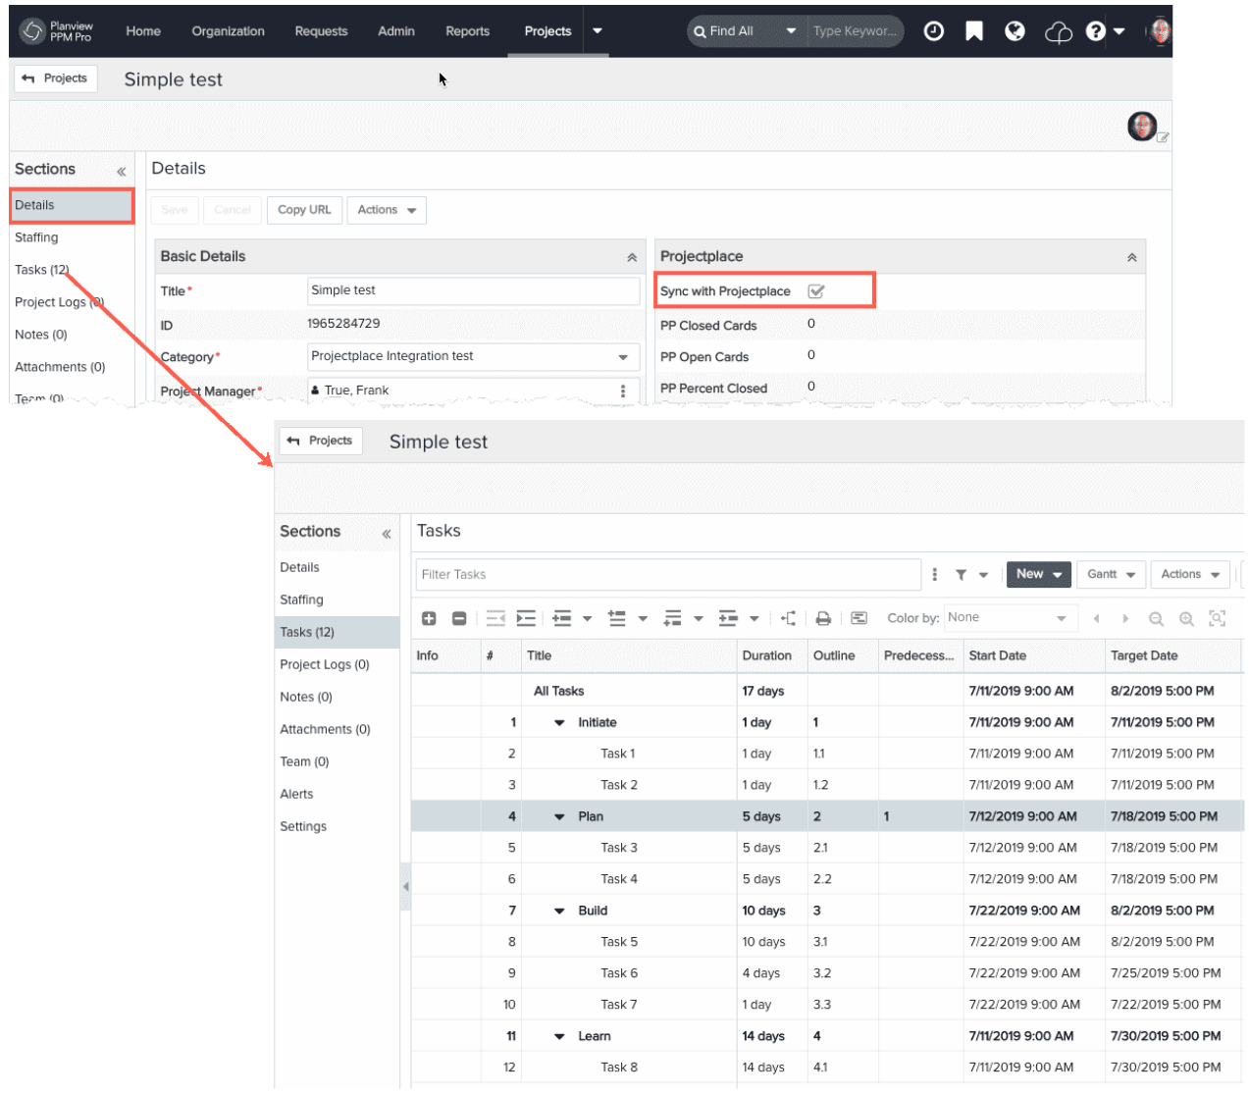
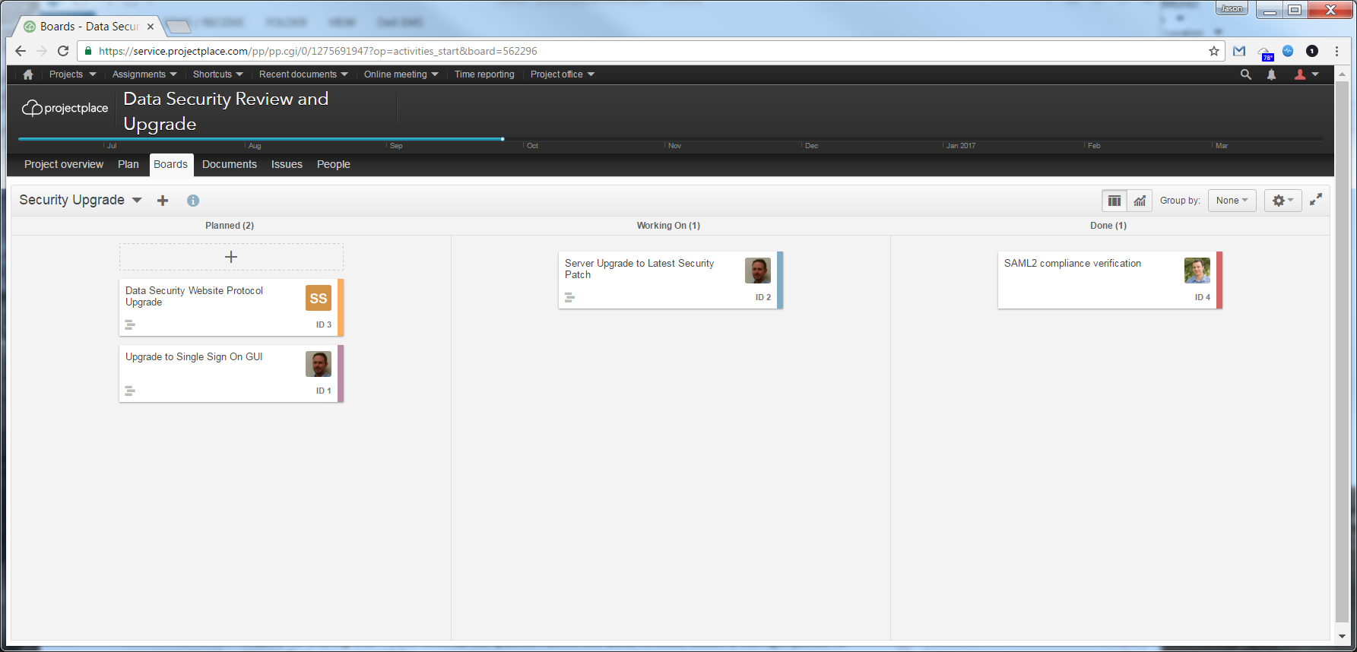
Synchronized Work Status
Synchronized WBS
Inline details of tasks (cards) connected to WBS items

Slide 5
PPMPro + Projectplace Integration: Features & Benefits
Work defined in PPMPro synchronized with Projectplace
Enables collaboration
Eliminates duplicate entry
PMOs and teams each work in their system of choice
Status updates sent automatically from Projectplace to PPMPro
Program/Project Managers can see Projectplace status in their system of choice
Status from Projectplace projects displayed in the larger context of an organization’s portfolios
Allows for easy time entry in Projectplace to seamlessly flow back into PPMPro

Slide 6
Different Types of Projects: Formal and Collaborative
The formal project is the traditional approach to project work. These tend to follow prescribed practices and leverage process-oriented methods to ensure on-time and on- budget delivery. They may be well- documented and have resources assigned in advance; those more strategic in nature may even have steering committees.
Collaborative work and projects power much of today’s organizations; it’s the day-to-day business of how we function. It can be small tasks, ongoing team deliverables, and those “surprise” projects that are called into existence seemingly in minutes with team members pulled from every conceivable nook of the organization.

Slide 7
The Benefits are Real
This joint solution of PPMPro and Projectplace for collaborative work gives you the power to:
Gain visibility into your people and strategic projects
Know that your people are focused on maximum-impact projects
Keep your people connected and your portfolio strategically aligned
Effectively manage your projects, formal and collaborative – with the right tool

Slide 8
Agenda
Setting up the Connector
Submitting Tickets
Gaining Access
Typical Issues and Solutions
Latest Functionality
The Connections
Connected Templates
Time Reporting
PPMPro / PP Sync Directions
Aligning to the Customer
Converting the Task or Sub-Task Level
Accelerating the Progress Feedback-Loop
Keeping the Team in the Team Collaboration tool

Slide 9
Setting up the Connector

Slide 10
Submitting the Ticket
Standard turnaround: 4-5 Days
Test that it works correctly ASAP
Worst case turnaround: 3 weeks

Slide 11
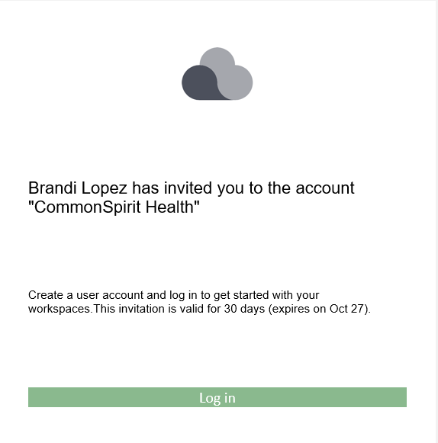
Gaining Access to Projectplace
The customer has the only access and must add you to Prod & SB
Walk the customer through giving you access
Walk the customer through making you an Administrator

Slide 12
Overview
PPM Pro and Projectplace work together at the task/activity level
With the integration enabled, users can sync PPM Pro projects to Projectplace workspaces.
When the integration is active, creating new tasks in PPM Pro results in the creation of corresponding Projectplace activities on a specified Projectplace workspace
Resources on the project Staffing screen are added automatically to the Projectplace workspace Members tab.
The Projectplace/PPM-Pro integration is available to users Team Member Plus and Team Member licenses.
Team Member Plus users can enter time in Projectplace, and view it in PPM Pro.
Using the self-service administration (SSA) facility, administrators can incorporate standard fields into PPM Pro project Details to set operational properties for the integration, and can use additional task fields to display data from the corresponding Projectplace card(s).
The integration can be activated on a project-by-project basis. Those PPM Pro projects that are participating in the integration will control the work breakdown structure (WSB/tasks).

Slide 13
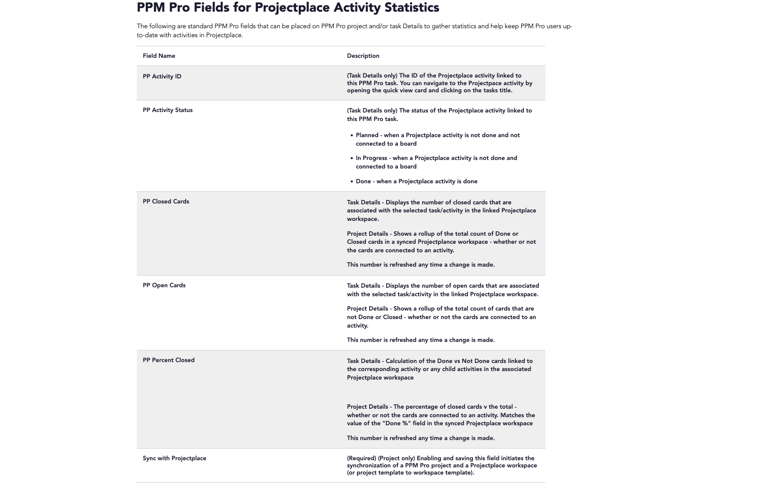
The PPMPro Project Fields
Key PP Fields to add to Project Details
Simplify and Align to the Customer’s Use Case
Notes:
Ensure Sync with Projectplace is a Yes/No instead of the Legacy options (Schedule Managed in Enterprise One)

Slide 14
Current Connector Functionality

Slide 15
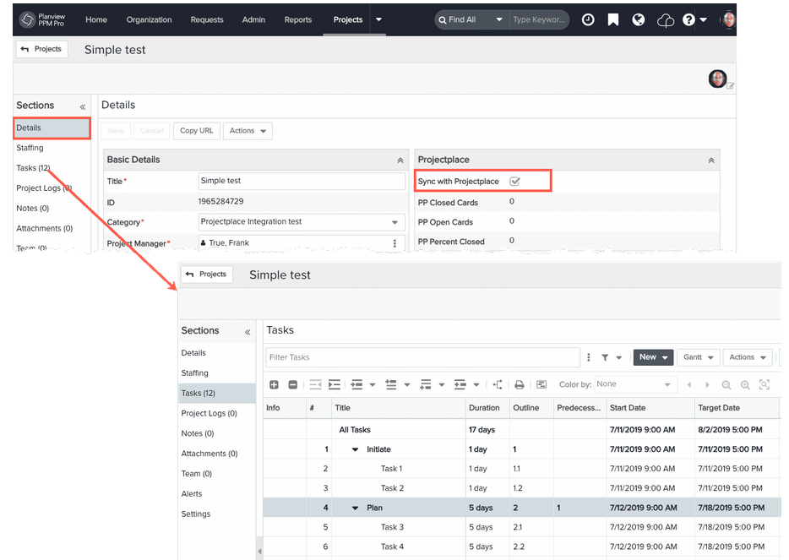
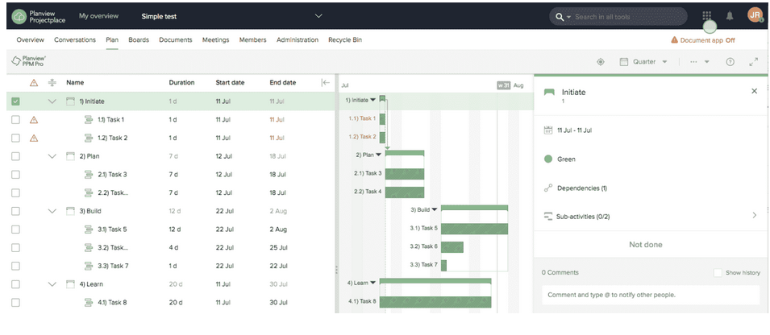
Connected Plans
Plan is Read-Only in PP
Inactive Statuses Hide Cards

Slide 16
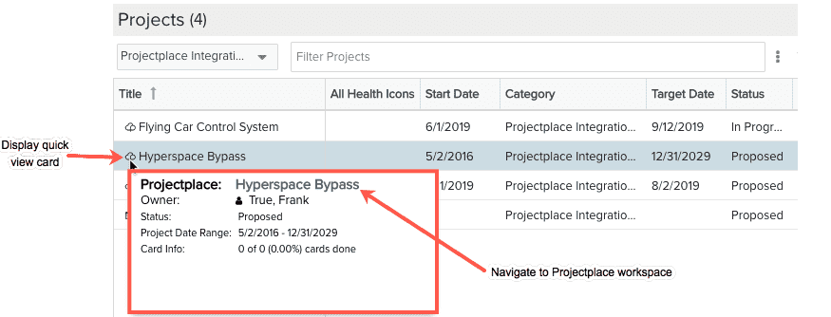
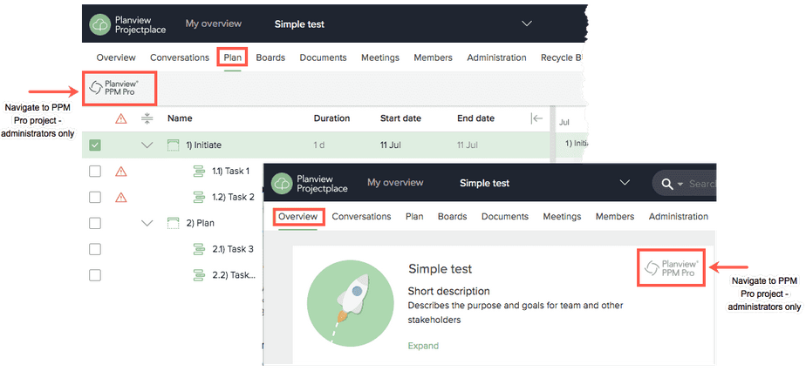
Working with Synced Projects and Workspaces
All tasks in the PPM Pro WSB will appear as activities in the Projectplace plan - one activity per task.
You can access PP by clicking on the icon In navigation bar or name of the WS in the quick view card
You can access PPMPro by clicking on the icon in the plan tab or on the overview tab.

Slide 17
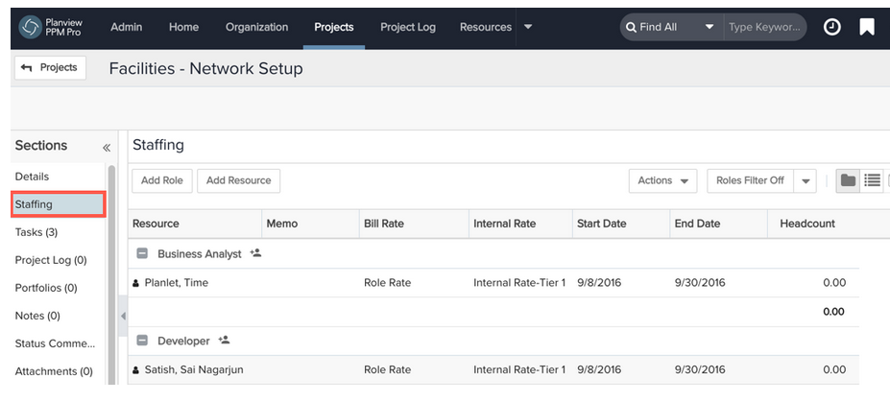
Project Staffing and Workspace Members
Any PPM Pro Time or Full users staffed to a synchronized project (project Staffing screen) who have a Projectplace account with an email address that matches the email address in their PPM Pro record will be added to the Members tab of the Projectplace workspace

Slide 18
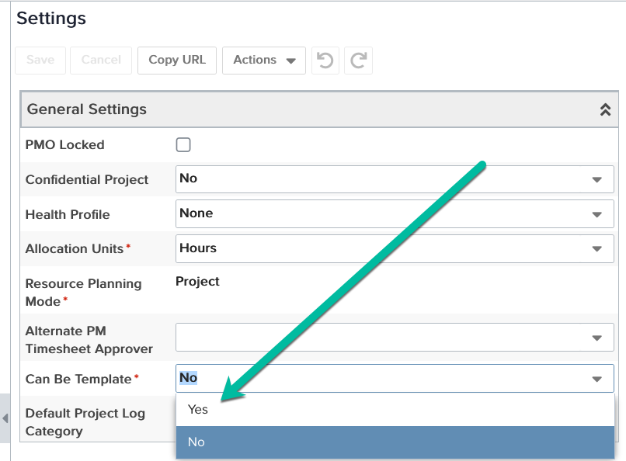
Syncing Templates
Syncing a PPM Pro project template results in a Projectplace workspace template.
Templates must be applied to a project before it is synced with Projectplace

Slide 19
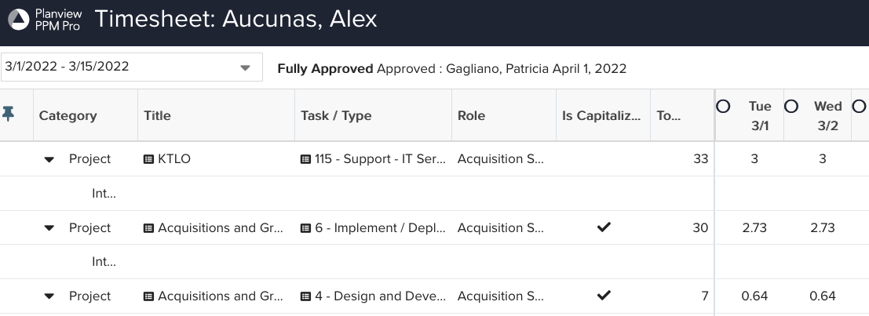
Time Reporting
Native Timesheets can be populated from Activities Only
Must ensure time tracking option is enabled by Customer care
Note: Users will see their PPMPro timesheet when they click on the Time Reporting in the rubic cube

Slide 20
Aligning the Customer

Slide 21
Initial Sync with Projectplace
Where in the Project Intake do you Sync?
Is Projectplace Sync Manual or Governed?
Sync Process Considerations
What selections are set for the Initial Sync?
Has the Template been selected?
Sync Process Questions
Is there a second template paste?
Is the Project Approved?

Slide 22
References
Before you begin
FAQ’s
Setting up the Integration
Using the Integration

