Slide 1
Maximizing Value with PPM Pro:What/If & PPA Overview
Rob Gatch, Senior Engagement Manager
Notes:
For any non-PSA opportunities --- Use This Slide for Intro

Slide 2
Purpose of Webinar
This session is intended to inform, educate and demonstrate how PPM Pro can impact your organization’s strategic goals around resourcing and staffing so that you stay on schedule and within budget. It will address how you can optimize the product to make sure that you are doing the right work at the right time, in order to bring the most value back to your organization
Notes:
For PSA Opportunities --- Use This Intro Slide for Intro

Slide 3
Agenda
Common Challenges​
PPA –Predictive Portfolio Analysis
What If
Key Takeaways​
Q&A
Notes:
For PSA Opportunities --- Use This Intro Slide for Intro

Slide 4
Common Challenges with Resource Management​
Managing resource capacity vs. demand and understanding who is available to take on new work and when​
Understanding what roles and/or skill sets to hire to fulfill stakeholder commitments​
Scheduling projects when appropriate resources are available​
Ensuring that resources are working on the highest priority, most well aligned work items
Notes:
For PSA Opportunities --- Use This Intro Slide for Intro

Slide 5
Strategic Resource Management
What does our current resource capacity pool look like, and how can we do more with it? ​
Effectively plan for future projects by:​
Developing a central resource pool and obtaining visibility into resource capacity​
Allocating resources to projects to accurately reflect demand & capacity ​
Identifying gaps where resources are not being utilized​
Generating real-time analytics to measure, manage, and track all work efforts
Notes:
For PSA Opportunities --- Use This Intro Slide for Intro

Slide 6
Analytics
Utilize the What-If capability to:​
Determine the impact of new work queued up in the Intake process against your current workload​
Perform resource capacity and demand analysis across portfolios and departmental boundaries​
Optimize your role/resource allocations to maximize the number of projects​
Adjust your staffing based on the analytics to optimize your work​
Ensure that you’re doing the “right work”
Notes:
For PSA Opportunities --- Use This Intro Slide for Intro

Slide 7
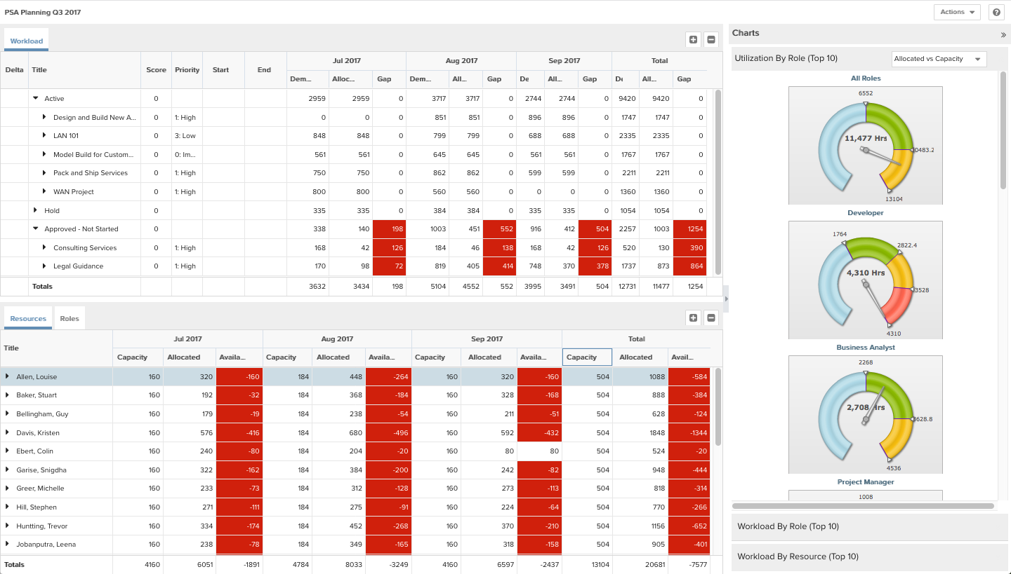
Plan Resources – What If
View projects, roles, and resource assignments and their current utilization
Test out the impact of shifting or excluding resources and roles to simulate lack of availability
Notes:
For PSA Opportunities --- Use This Intro Slide for Intro

Slide 8
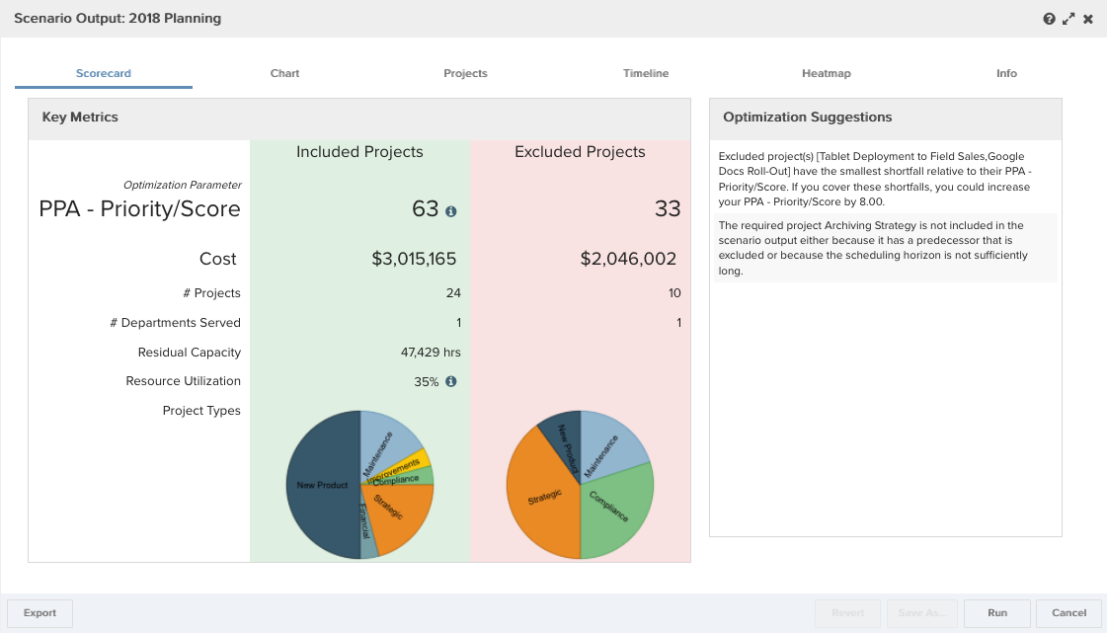
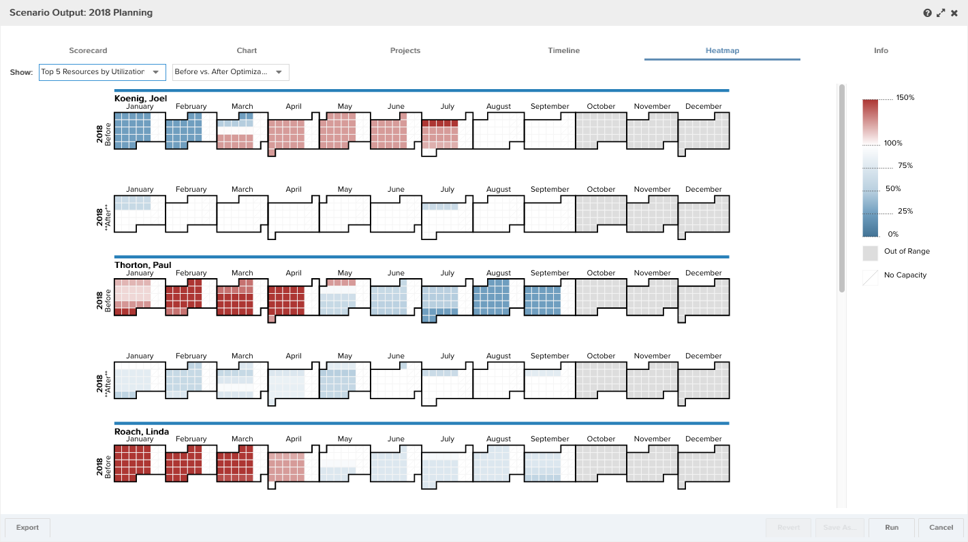
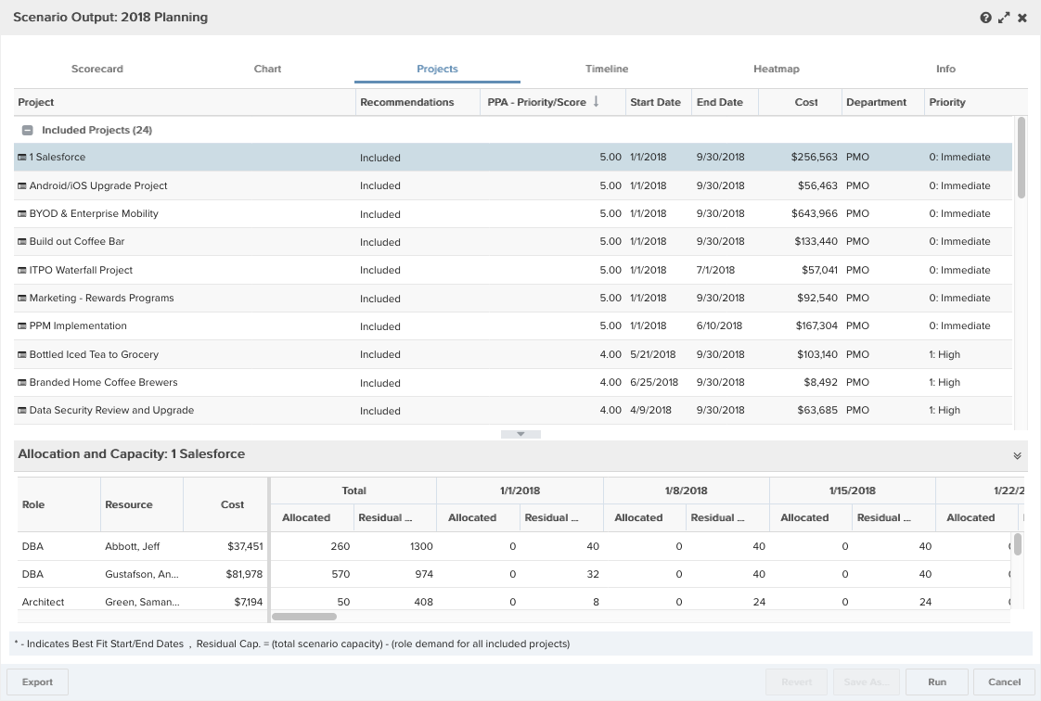
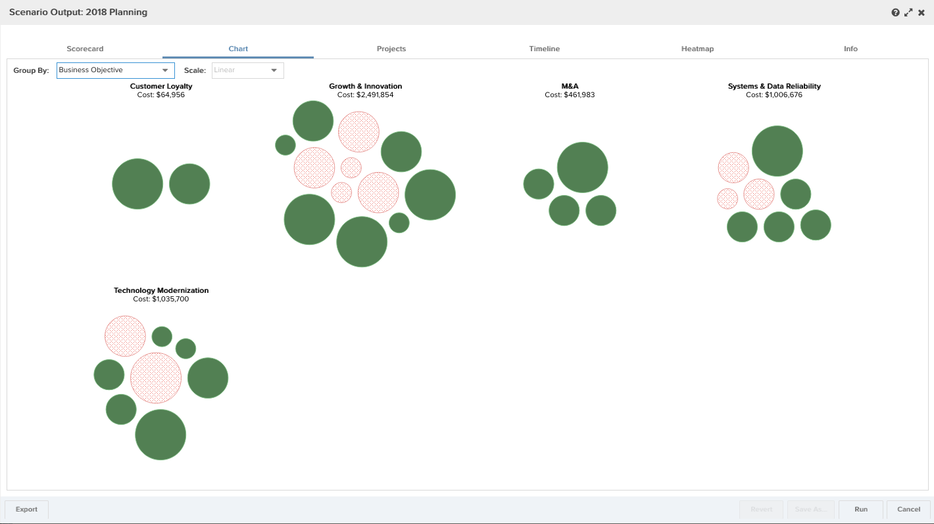
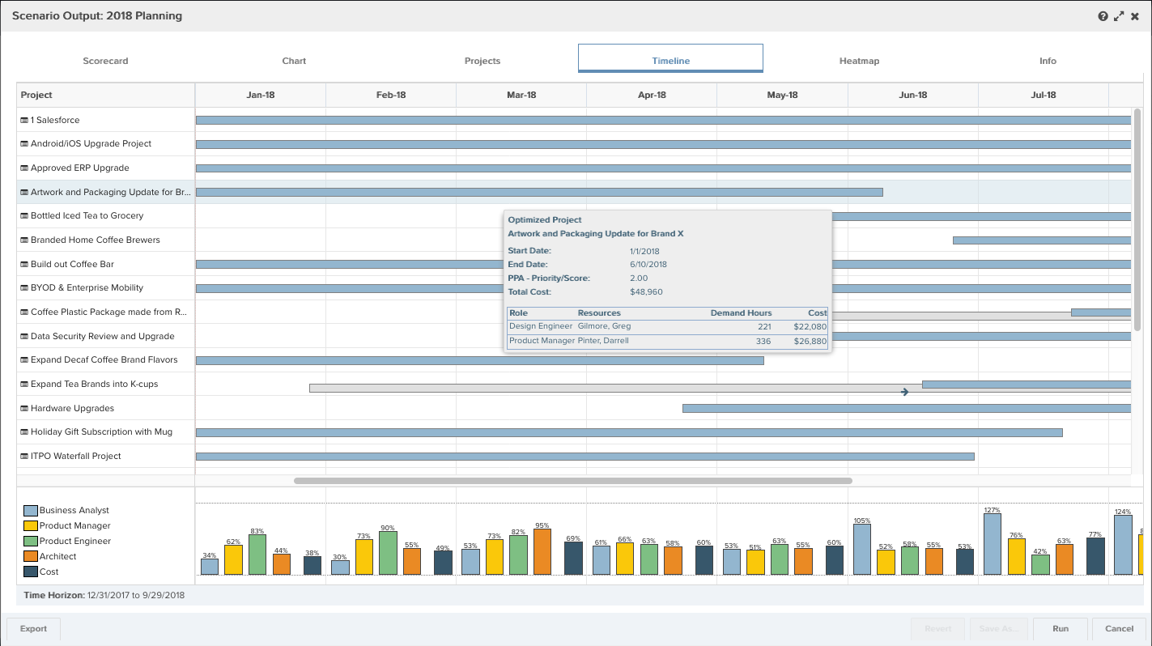
Predictive Portfolio Analysis
Optimize and re-plan project work based on both priorities and your people capacity using Predictive Portfolio Analysis (PPA)
Use when you have:
Available resources represented
Roles allocated on requested and in-flight projects
Projects to be analyzed all have a numeric value for use as optimization parameter
Notes:
For PSA Opportunities --- Use This Intro Slide for Intro

Slide 9
Key Takeaways
MAKE YOUR MOVE
Prioritize your work for strategic alignment and best use of monetary and human resources
Plan and replan your resources and work as priorities change
Make sure your data is relevant and quality for the best planning decision making
Notes:
For PSA Opportunities --- Use This Intro Slide for Intro

Slide 10
Thank You
Rob Gatch, Senior Engagement Manager

