Slide 1
Program Backlog Management > Program Capacity Planning > Program Delivery: MASTER
Portfolio Backlog Management
Program Backlog Management
Program Execution
Capture relevant prioritization information (e.g., WSJF)
Create features
Describe and categorize features
Prioritize program backlog
Sequence features into appropriate timebox (e.g., iteration)
Deliver features through underlying stories
Estimate sizes
Team Backlog Management
Carry out visual capacity planning
Deliver cross-program dependencies
Monitor progress through key results
Program OKRs
Set Team of Teams capacity using WIP limits
Cross-Program Coordination
Create and define objectives
Define current and target metrics (key results) for objectives
Program Capacity Planning

Slide 2
Program Backlog Management > Program Capacity Planning > Program Delivery: Agile Program Planning
Portfolio Backlog Management
Program Backlog Management
Program Execution
Capture relevant prioritization information (e.g., WSJF)
Create features
Describe and categorize features
Prioritize program backlog
Sequence features into appropriate timebox (e.g., iteration)
Deliver features through underlying stories
Estimate sizes
Team Backlog Management
Carry out visual capacity planning
Deliver cross-program dependencies
Monitor progress through key results
Program OKRs
Set Team of Teams capacity using WIP limits
Cross-Program Coordination
Create and define objectives
Define current and target metrics (key results) for objectives
Program Capacity Planning

Slide 3
Program Backlog Management > Program Capacity Planning > Program Delivery: Agile Program Delivery
Portfolio Backlog Management
Program Backlog Management
Program Execution
Capture relevant prioritization information (e.g., WSJF)
Create features
Describe and categorize features
Prioritize program backlog
Sequence features into appropriate timebox (e.g., iteration)
Deliver features through underlying stories
Estimate sizes
Team Backlog Management
Carry out visual capacity planning
Deliver cross-program dependencies
Monitor progress through key results
Program OKRs
Set Team of Teams capacity using WIP limits
Cross-Program Coordination
Create and define objectives
Define current and target metrics (key results) for objectives
Program Capacity Planning

Slide 4
Team Backlog Management > Team Execution + Cross-Team Coordination: MASTER
Program Backlog Management
Team Backlog Management
Team Execution
Cross-Team Coordination
Create stories
Describe and categorize stories
Estimate story sizes
Prioritize story backlog
Deliver stories
Deliver cross-team dependencies
Schedule stories into appropriate timebox (e.g., sprint)
Assign stories to relevant team members
Team OKRs
Create and define objectives
Define current and target metrics (key results) for objectives
Monitor progress through key results

Slide 5
Team Backlog Management > Team Execution + Cross-Team Coordination : Agile Team Delivery
Program Backlog Management
Team Backlog Management
Team Execution
Cross-Team Coordination
Create stories
Describe and categorize stories
Estimate story sizes
Prioritize story backlog
Deliver stories
Deliver cross-team dependencies
Schedule stories into appropriate timebox (e.g., sprint)
Assign stories to relevant team members
Team OKRs
Create and define objectives
Define current and target metrics (key results) for objectives
Monitor progress through key results

Slide 6
Team Backlog Management > Team Execution + Cross-Team Coordination : Agile Team Planning
Program Backlog Management
Team Backlog Management
Team Execution
Cross-Team Coordination
Create stories
Describe and categorize stories
Estimate story sizes
Prioritize story backlog
Deliver stories
Deliver cross-team dependencies
Schedule stories into appropriate timebox (e.g., sprint)
Assign stories to relevant team members
Team OKRs
Create and define objectives
Define current and target metrics (key results) for objectives
Monitor progress through key results

Slide 7
Product Funding
Product Planning
Product Funding
Capacity Targets
Create product
Describe and categorize product
Create / manage product roadmap
Identify and document product objectives / benefits
Manage financial budgets / targets
Manage capacity targets:
Team of teams
Analysis and Prioritization / Portfolio Capacity Planning

Slide 8
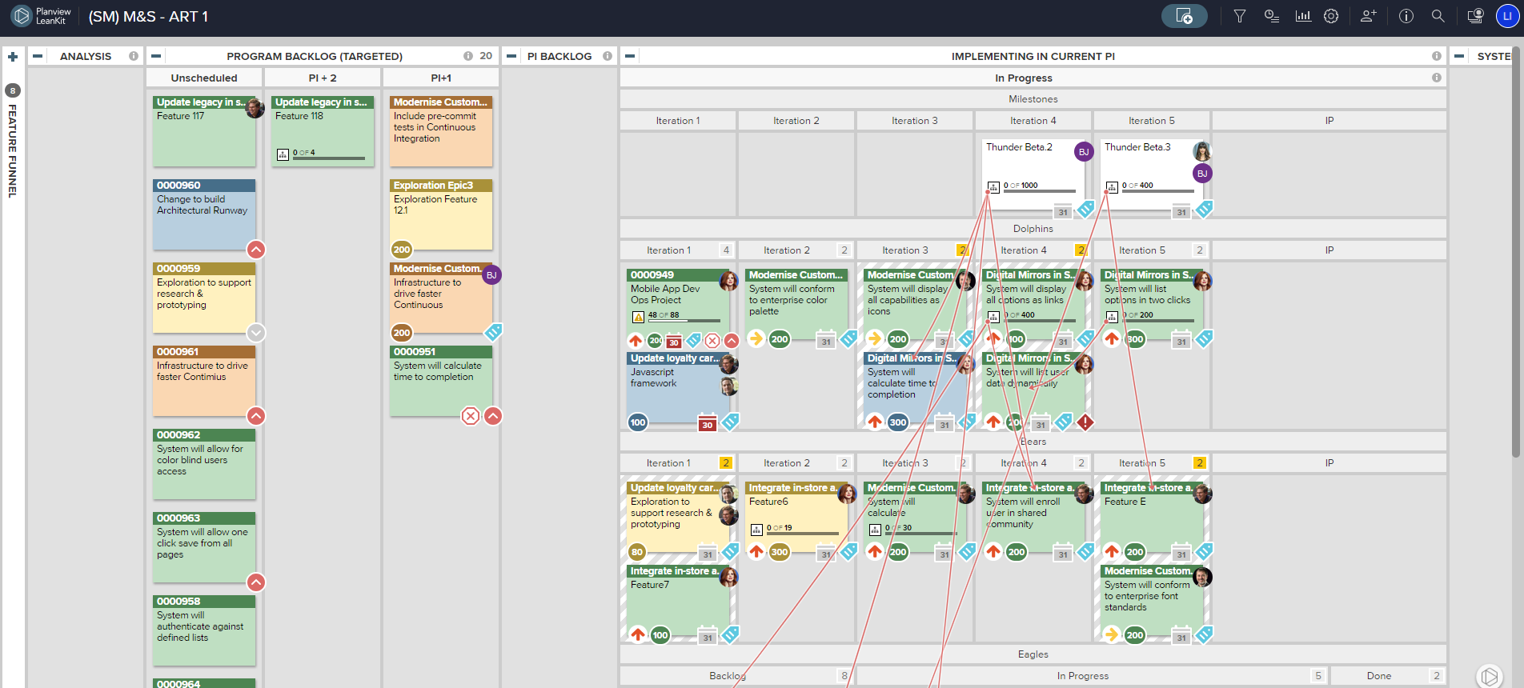
Epic Portfolio Planning
Demand Intake (Governance)
Epic Financial Planning
Analysis and Prioritization / Portfolio Capacity Planning
Create epic
Describe and categorize epic
Associate to relevant products
Capture prioritization information (e.g., WSJF)
Estimate sizes
Prioritize
portfolio
backlog
Set portfolio budget and targets
Product Funding / Capacity Targets
Manage cost and revenue/KPIs
(Lean Business Case)
Portfolio OKRs
Key prioritized
epics
Consolidate actuals
Create and define objectives
Define current and target metrics (key results)
Sync epics across to portfolio board
Portfolio Backlog Management
Monitor progress through key results
Deliver epics through underlying features and stories
Sequence epics into appropriate timeboxes (e.g., PI)
Program Backlog Management

